Slide 1

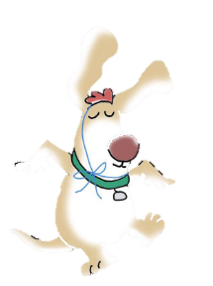
Sandra Boynton
April 3, 1953 -----
Sandra says she had an “absurdly happy childhood” in Philadelphia, Pennsylvania.

Slide 2
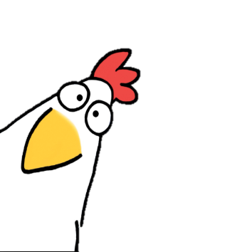
In Boynton's world, animals do whatever she wants. And what she wants them to do, mostly, is make her smile.

Slide 3
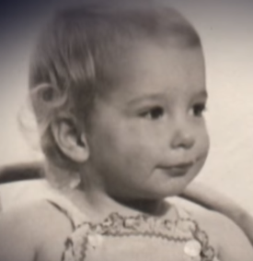
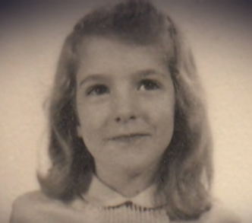
Little Sandra Boynton
She wrote her first children’s book at age four; it was called The Funny Animal, and the entire text goes:
“Once there was a funny animal. One day he had a birthday party. All the animals came. They did not like it, so they left. The end.”
When she was in the 10th grade, she was paid $40 for her drawings by a newspaper that published them.
She bought two shares of AT&T with the money.

Slide 4
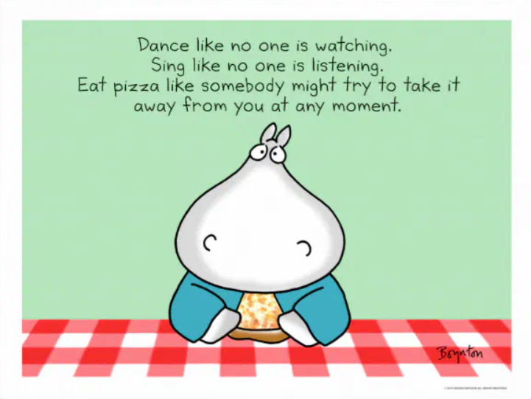
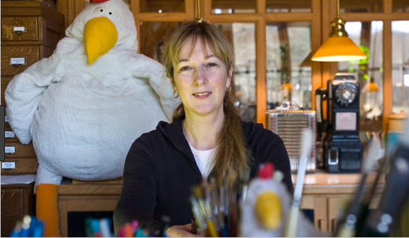
Words to live by…
Her dad was an English teacher at her high school. “The best English teacher I ever had,” she says. And her mother “was a pointedly funny homemaker.”

Slide 5
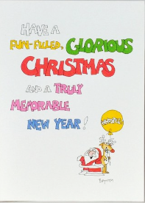
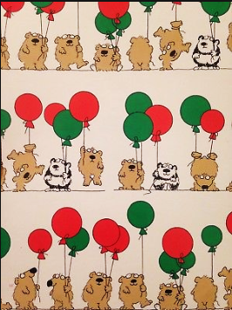
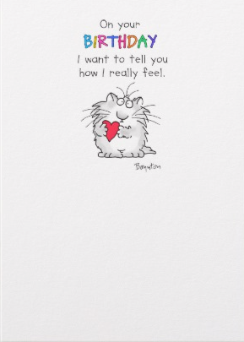

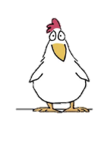
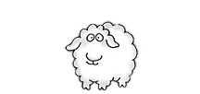
To help pay for college, she drew and painted the cartoon-style animals she'd been sketching since childhood onto blank gift cards and sold 60,000 of them to specialty shops.

Slide 6
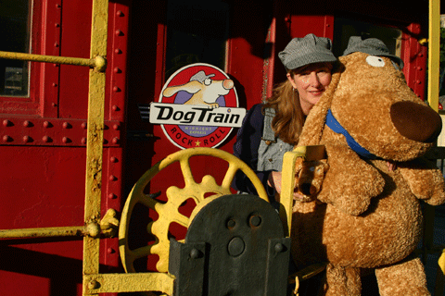
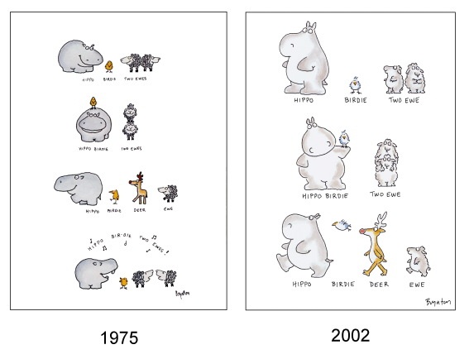
Her best-known card is a “Hippo Birdie Two Ewes,” first printed in 1975, which has been redrawn five times and has sold 10 million copies.
Sandra majored in English at Yale University, not art. “Drawing,” she says, "does not come naturally to me.“ She creates what brings her joy and makes her smile.

Slide 7
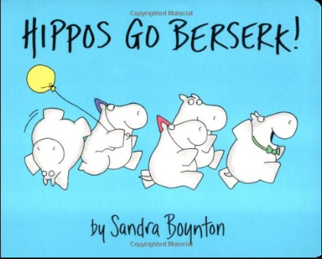
First book
Her greeting cards and stickers fit naturally into children’s books.
“I wrote my first children’s book, Hippos Go Berserk, in 1977 as a project while I was a grad student at the Yale School of Drama.”
It sold 50,000 copies and got the publishing world's attention.

Slide 8
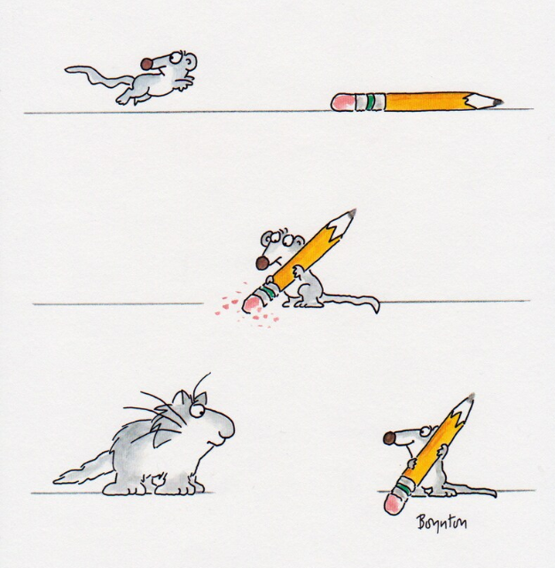
If you were to tell this story, what would it be?
?
?
?

Slide 9

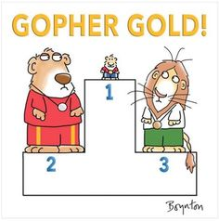
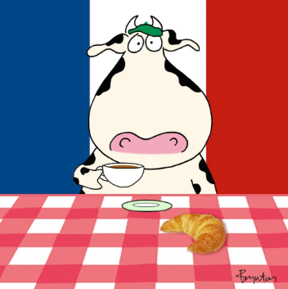
Fun Facts about Sandra Boynton
What skill do you think Sandra would like to have?
Figure skating
Gymnastics
Tap dancing
One of her sons (like her husband) was in the Olympics for…?
Skeet shooting
Snowboarding
Slalom Canoeing
What country did Sandra and her family move to for a year?
Italy
Russia
France
C
C
C

Slide 10
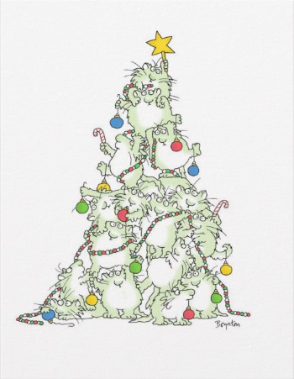
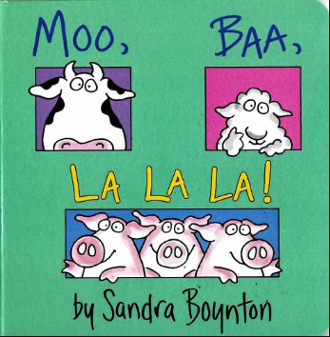
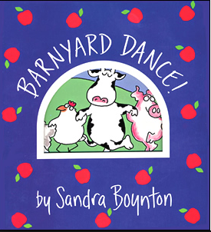

Artistic Success
Over 60 children’s books published
Over 4,000 greeting cards designed
Six CDs of music she has written and produced, including receiving a Grammy nomination

Slide 11
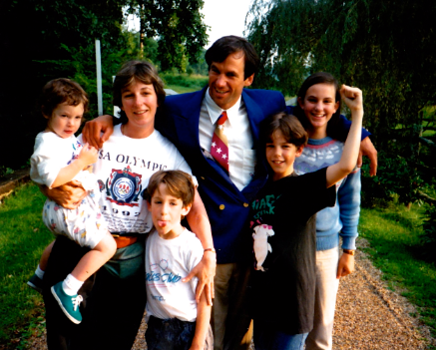

What now?
Sandra continues to create, channeling her inner child everyday.
She works with a few people to help on projects. Her sister helps maintain her website, www.sandraboynton.com.
But mostly, Sandra
works on her own.
This is a picture from the 1992 Olympics.
Sandra lost her husband to cancer
in 2014. She spends her free time with her adult children.

Slide 12
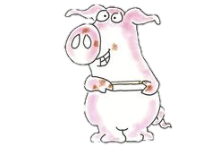

Drawing cartoon figures is harder than you think but we can do it with a little practice.
Simple is harder, because you have to remove the details and what you’re left with has to make sense.
Artists practice, practice, practice.

Slide 13

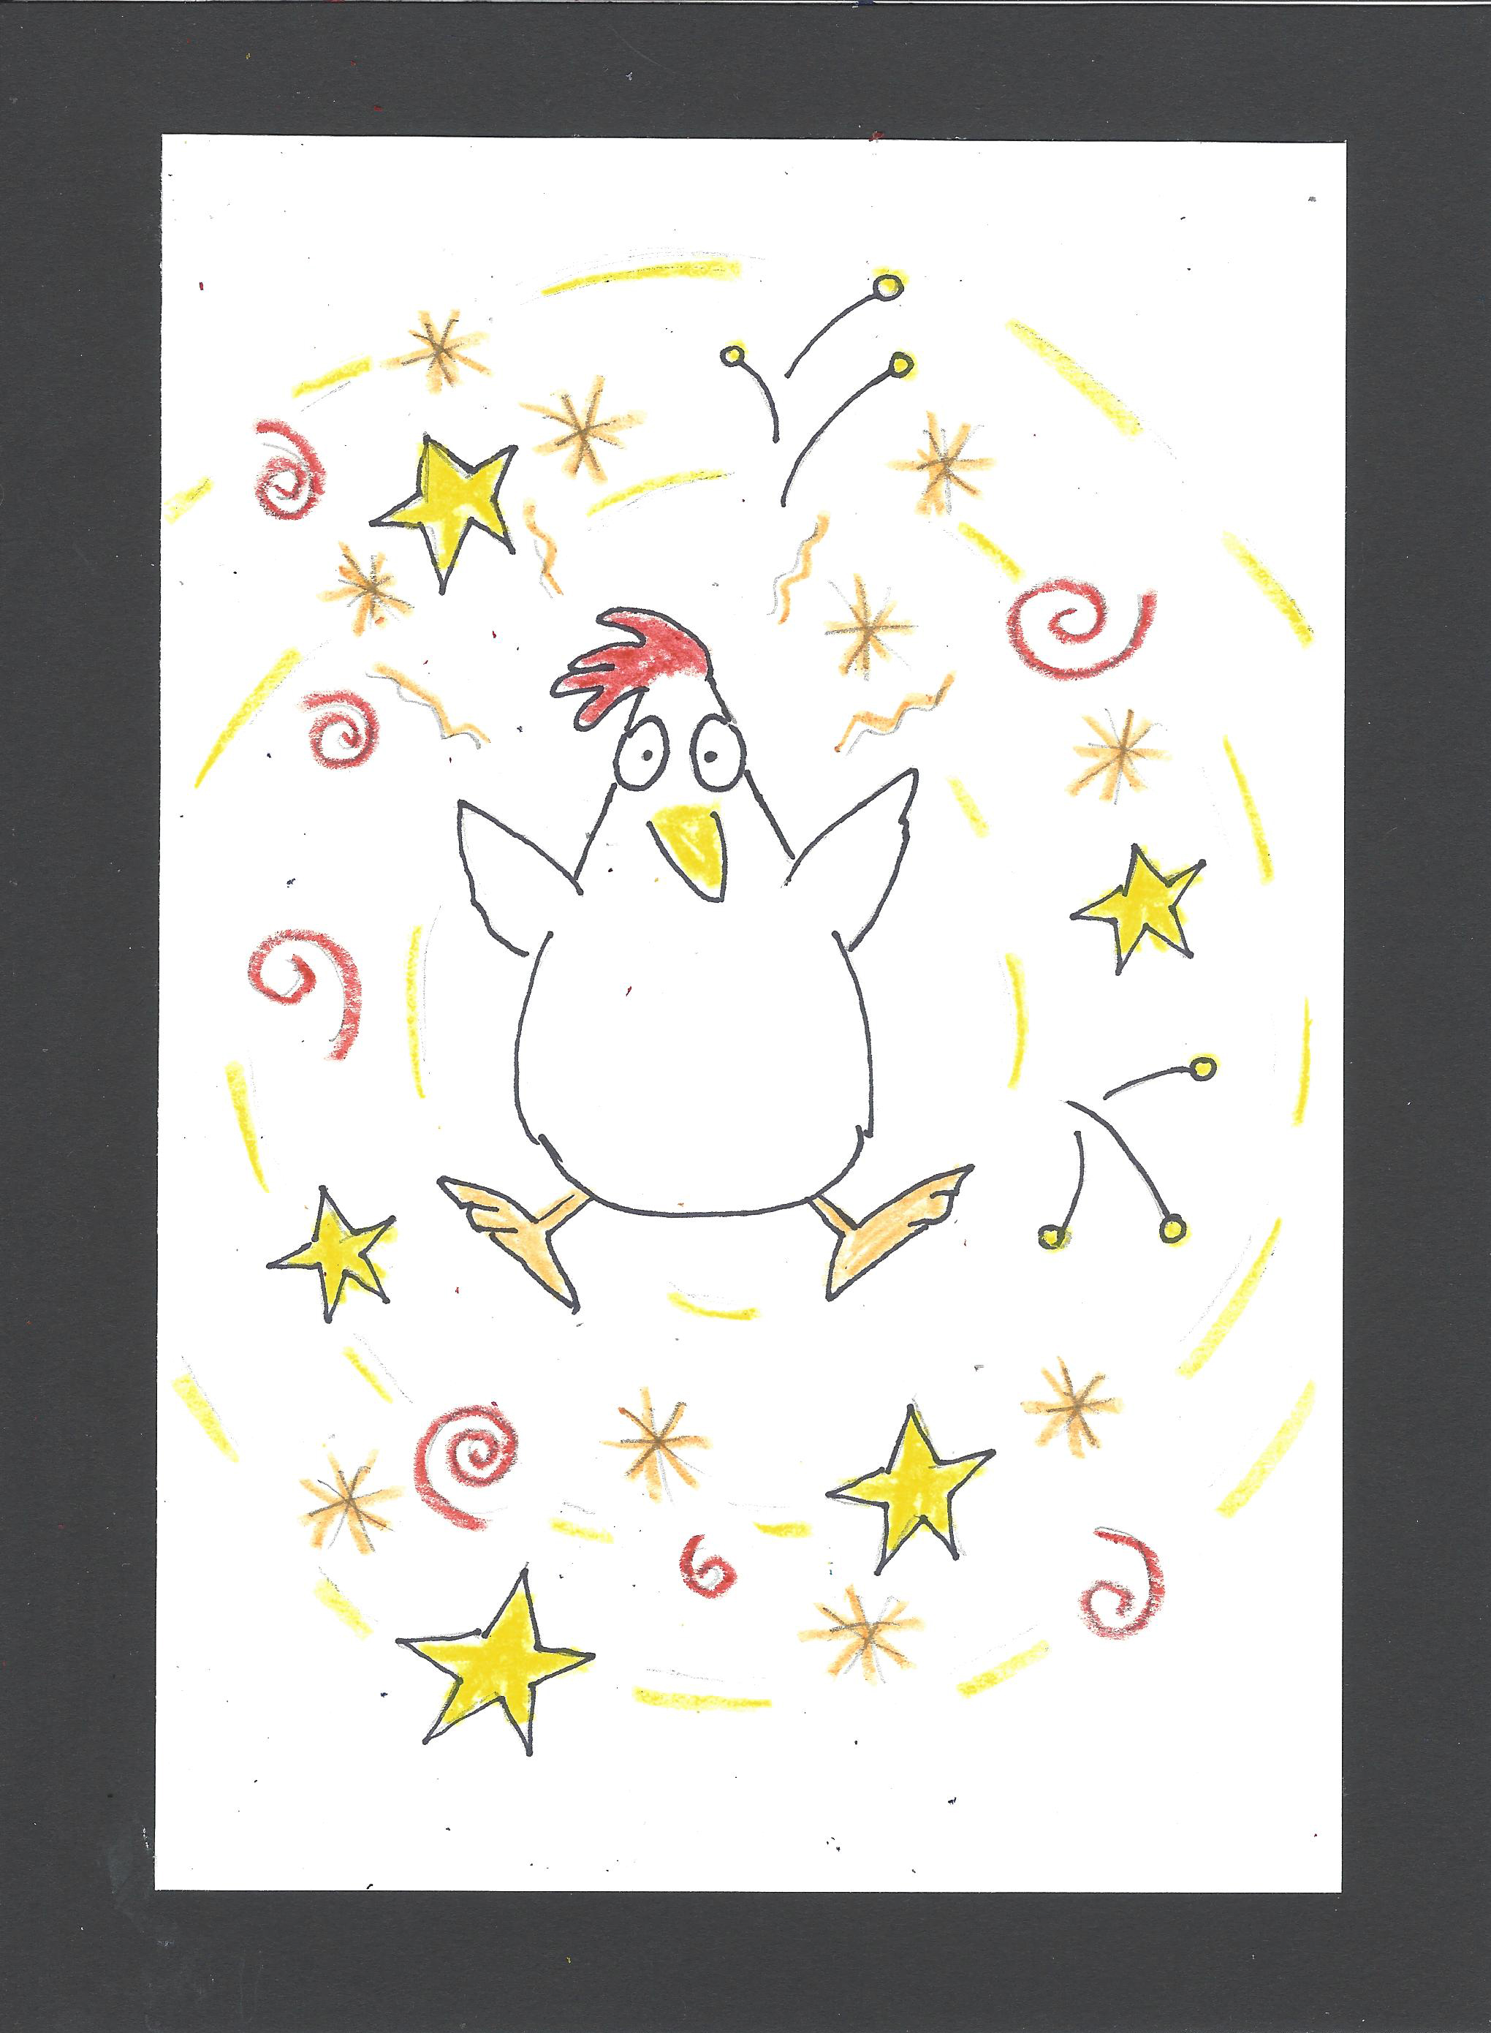
Chicken
Art Supplies:
5.5” x 8.5” Cardstock
Pencil & eraser
Colored pencils
Fine black marker
Practice paper
Art Fundamentals:
Simplicity of form
Patterns and movement
Rhythm
Children book illustrations

Slide 14
Put your name on your papers

Slide 15

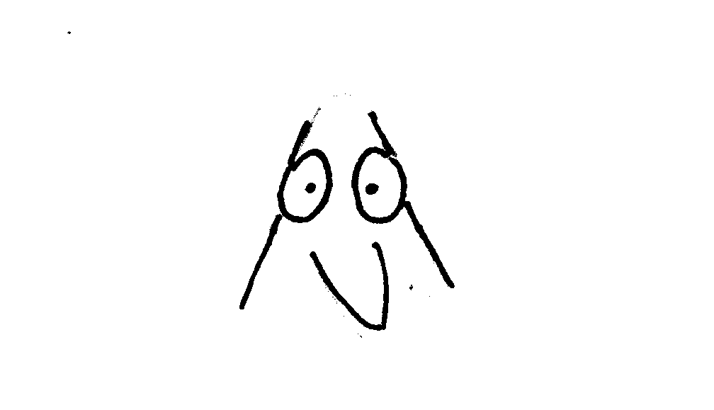
Drawing Steps - Practice on scrap paper
1.
2.
Notes:
Kids should only work on their scratch paper.

Slide 16
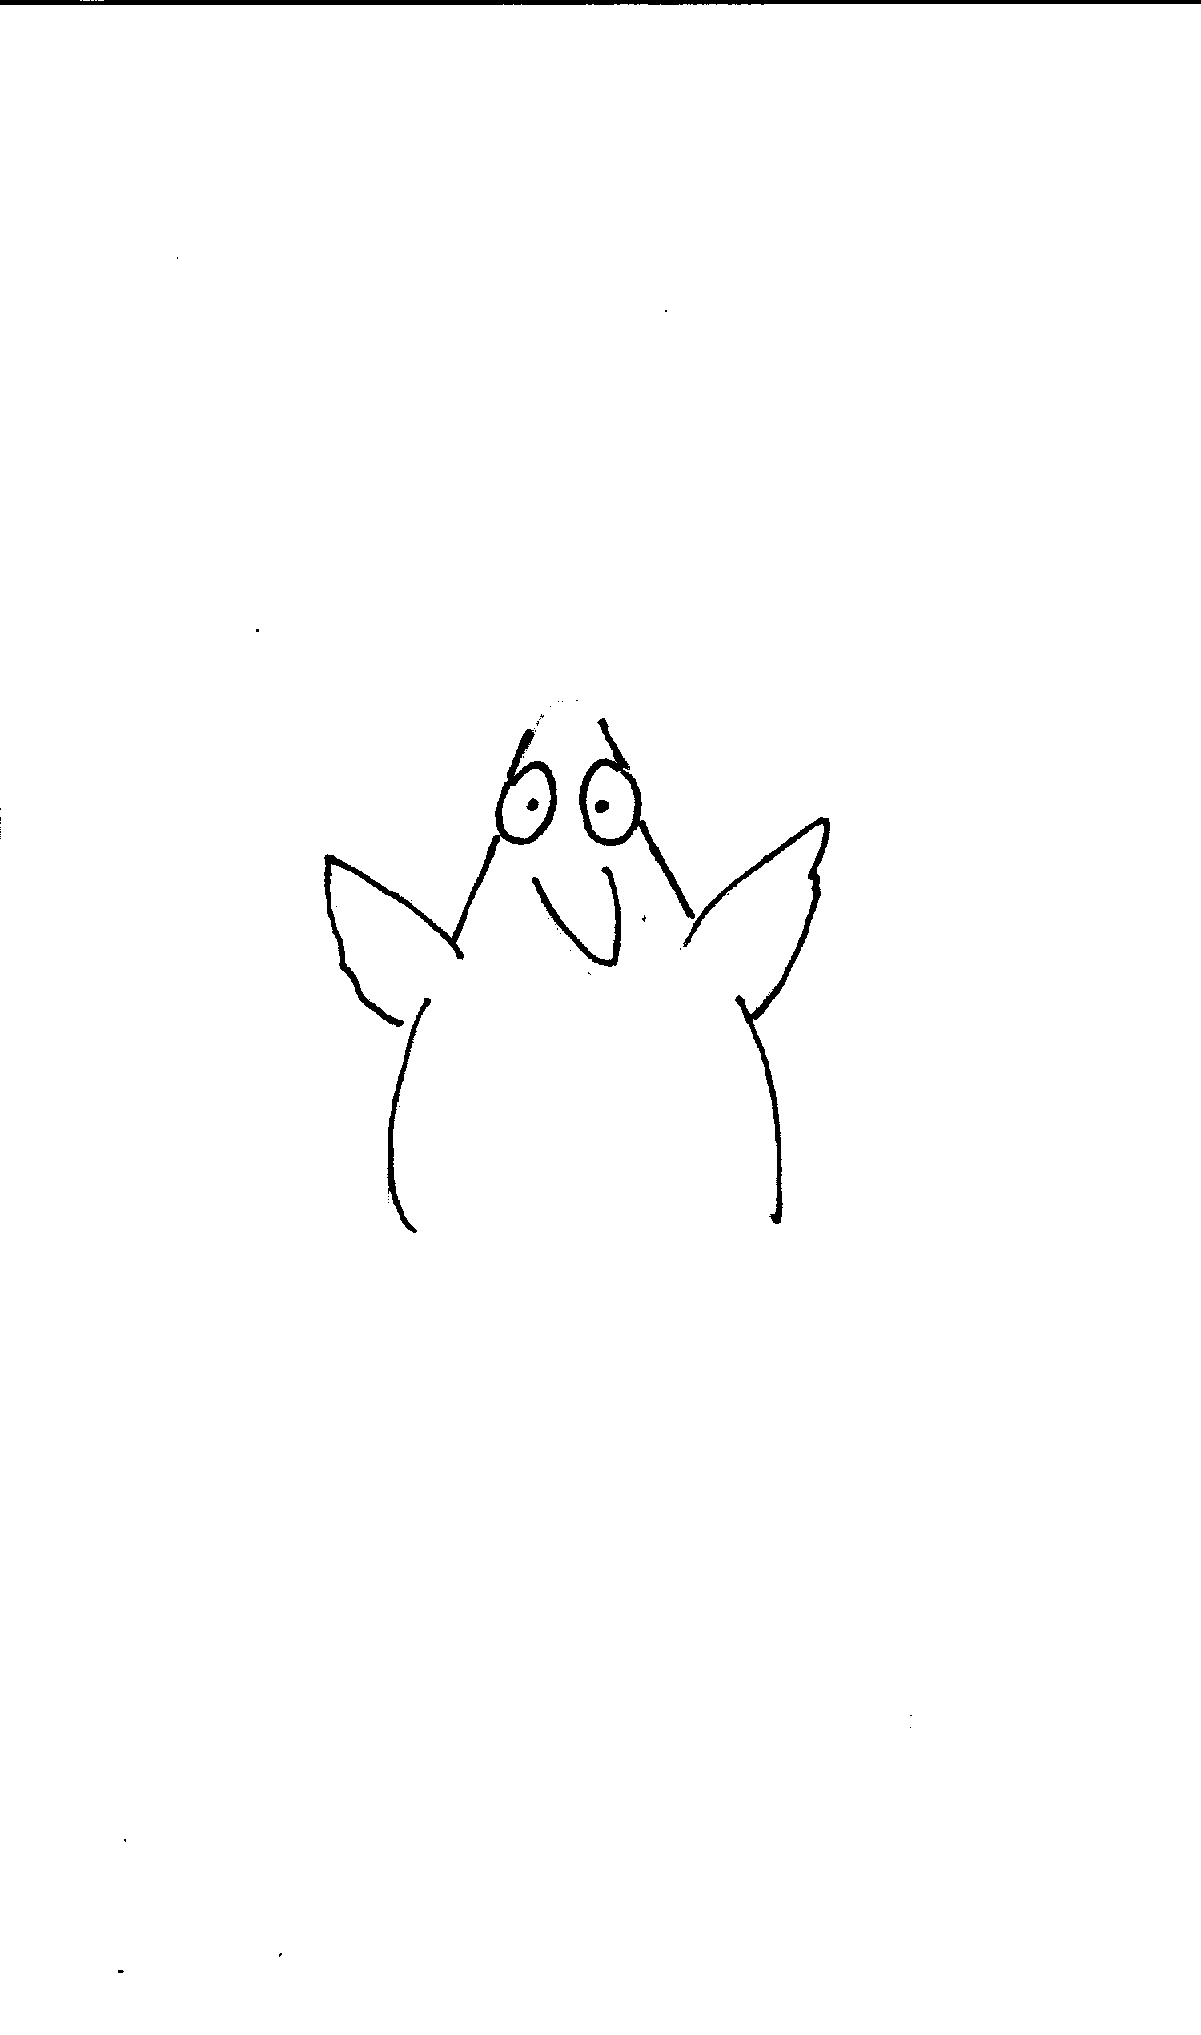
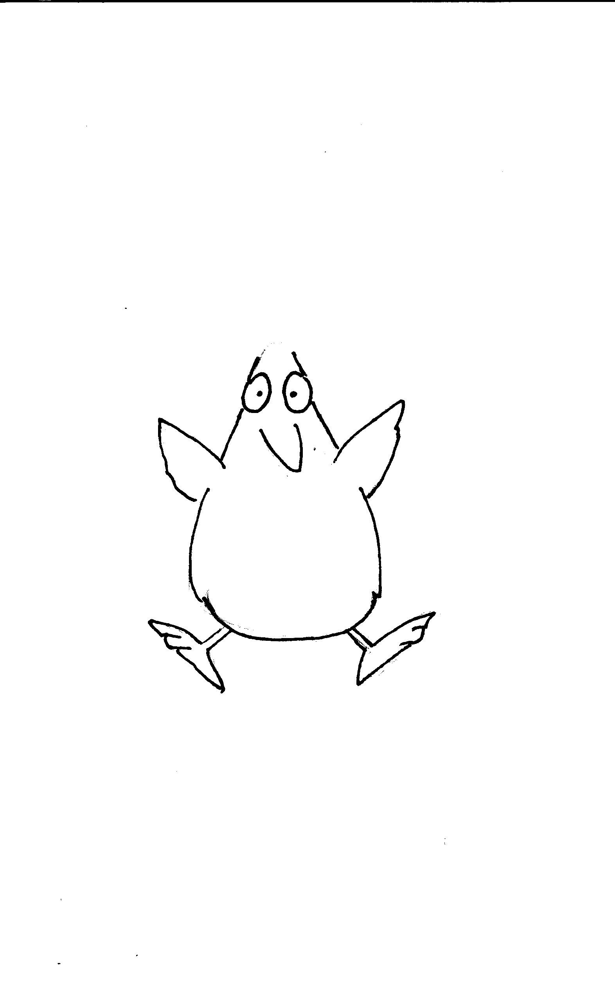
Drawing Steps
3.
4.
Notes:
Kids should only work on their scratch paper.

Slide 17
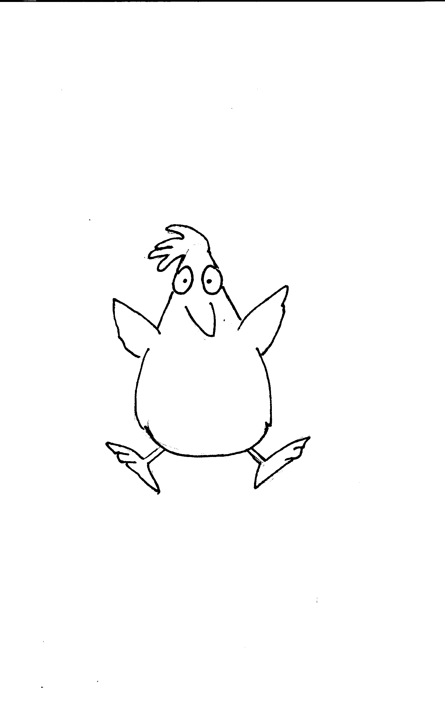
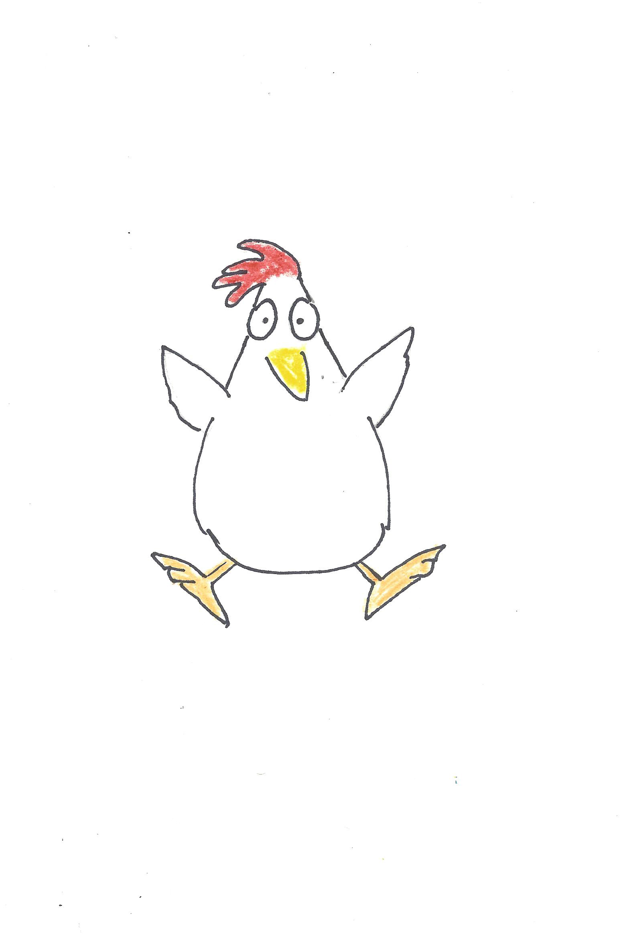
Drawing Steps
3.
4.
Notes:
Kids should only work on their scratch paper.

Slide 18
On your art paper – center your chicken
1.
2.
3.
4.
5.
6.
Notes:
Kids should only work on their scratch paper.

Slide 19
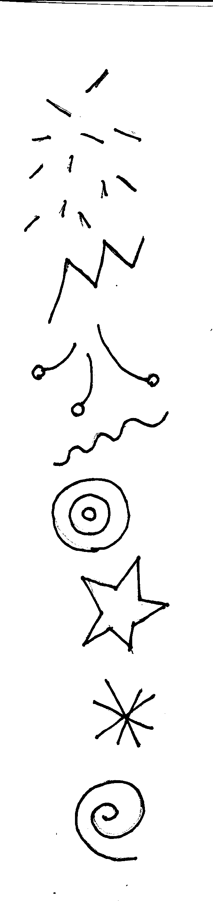
Steps to create movement
1.
In the center of your paper, draw the chicken. Then OUTLINE with black sharpie.
2.
Add a series of shapes to produce the feeling the chicken is moving.
3.
Add color inside the moving shapes. Sandra Boynton added a minimal amount of color.

Slide 20
REFERENCES
http://www.sandraboynton.com
https://americanprofile.com/articles/sandra-boynton-greeting-cards/
https://news.harvard.edu/gazette/story/2016/02/sandra-boynton-shares-her-story/
https://www.publishersweekly.com/pw/by-topic/childrens/childrens-book-news/article/77817-a-bustling-year-for-sandra-boynton.html
https://youtu.be/QhIttZMMDZE
https://www.washingtonpost.com/lifestyle/style/hippos-birdies-t-rexes-pigs-how-sandra-boynton-built-an-empire-and-won-your-childs-heart/2017/09/12/9f99a0b6-95c8-11e7-89fa-bb822a46da5b_story.html?noredirect=on&utm_term=.d07f5514571e
https://www.sketchbook.com/blog/how-to-draw-from-imagination-why-is-it-so-hard/

Slide 21



I HOPE YOU ENJOYED THIS LESSON
Stay Curious!
Rachel Allen Dillon
www.RachelDillon.com

