Slide 1
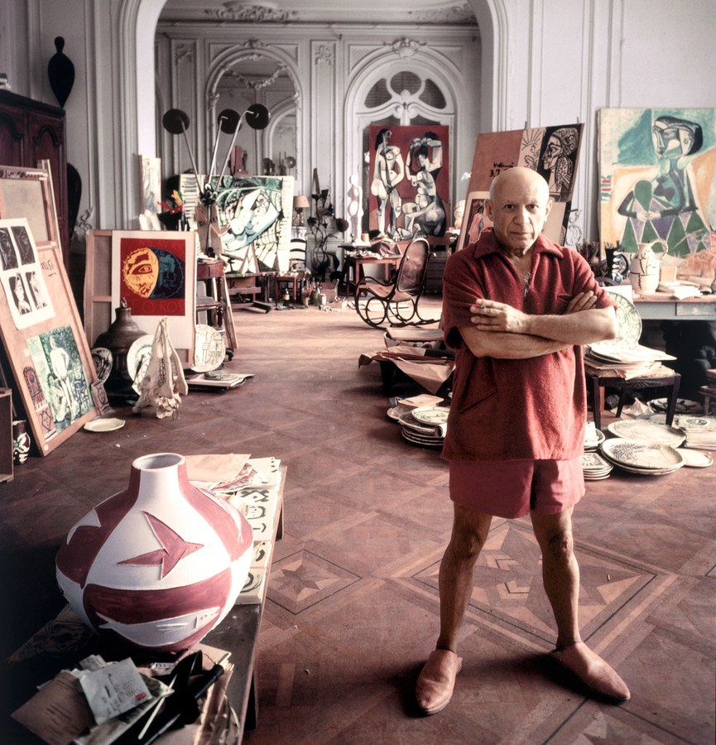
Pablo
Picasso
1881-1973

Slide 2
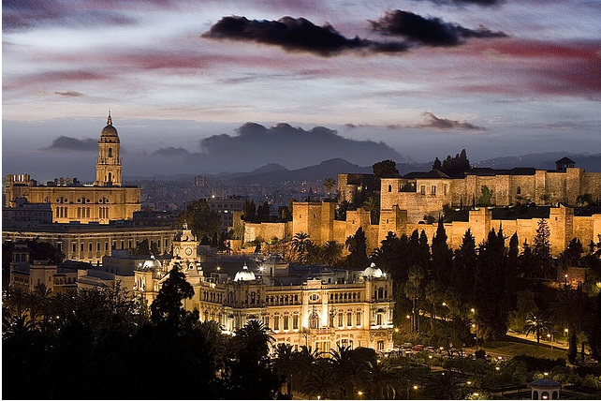
Picasso is from Spain
Pablo Picasso was born Málaga, Spain in 1881.
Photo of where he was born

Slide 3
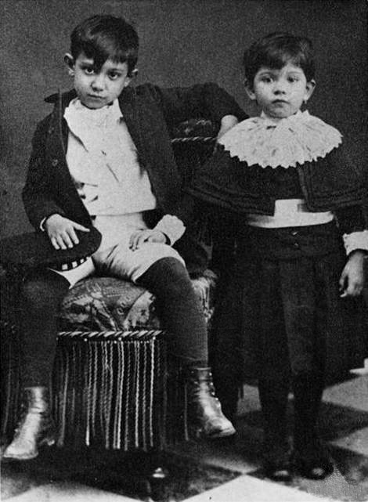
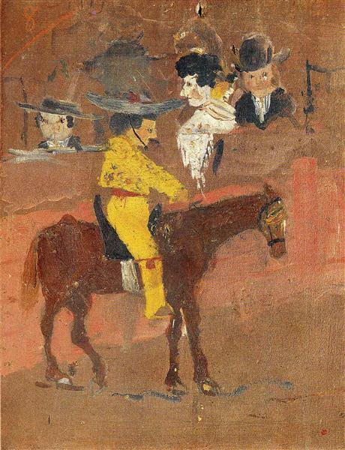
Childhood
Pablo struggled with math and would sometimes draw pictures with the numbers and symbols instead of doing the problems.
His dad was a painter and saw that Pablo was a talented artist.
When Pablo was 13, his dad asked him to finish a painting he had started. His dad was so impressed he gave all of his paints and brushes to his son.
Pablo and his little sister.
A painting done by Pablo at the age of 9.

Slide 4
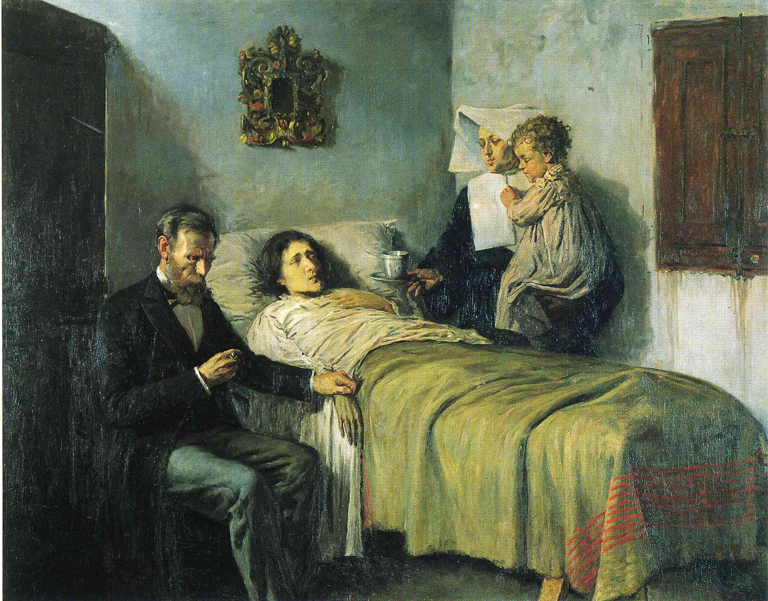
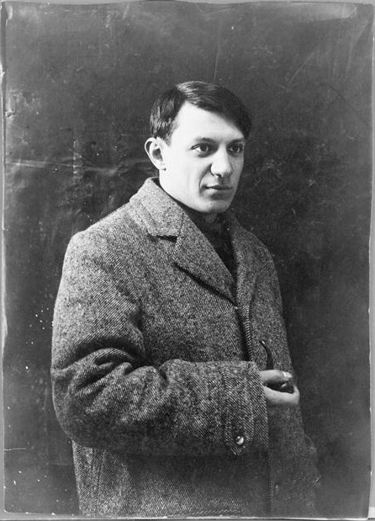
Art Education
At 14, Picasso began studying art in Barcelona. In 1897, he enrolled in a fine arts academy in Madrid. He decided art school wasn’t exciting enough, so he left.
At 19, he travelled to Paris, France. Paris at the time, was a place with a lot of talented and famous artists, and it inspired Picasso.
Science and Charity, 1897 (Picasso was 16 when he painted this)

Slide 5
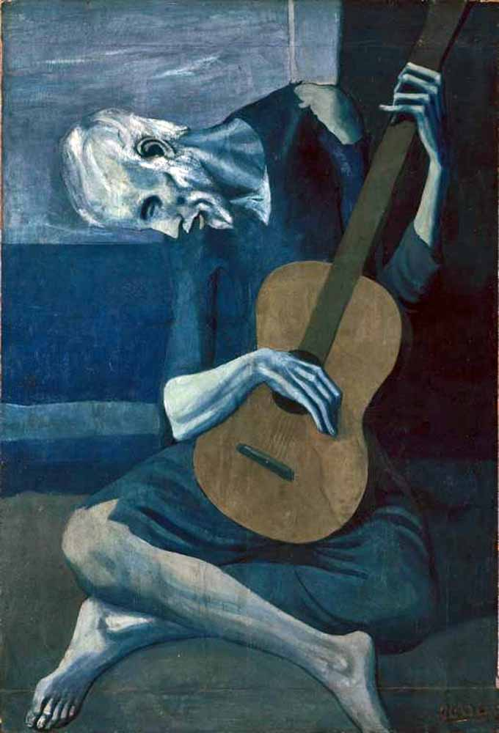
1901
After Picasso’s best friend died, his work changed. It affected his artwork for years.
Questions for you!
?
What do you notice about this painting?
How does this painting make you feel?

Slide 6
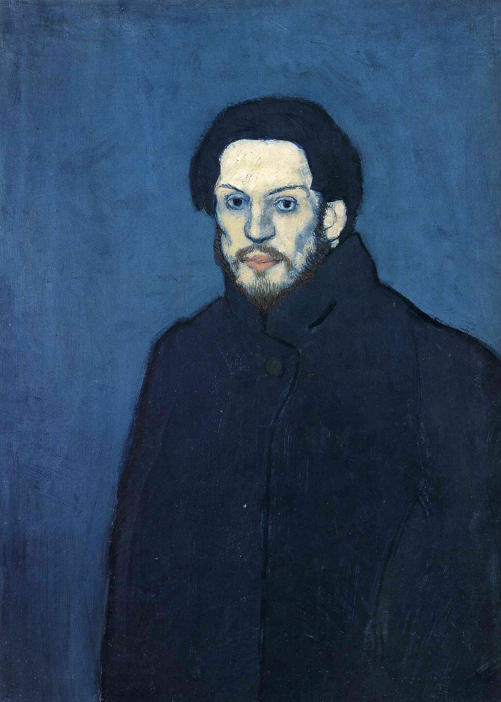
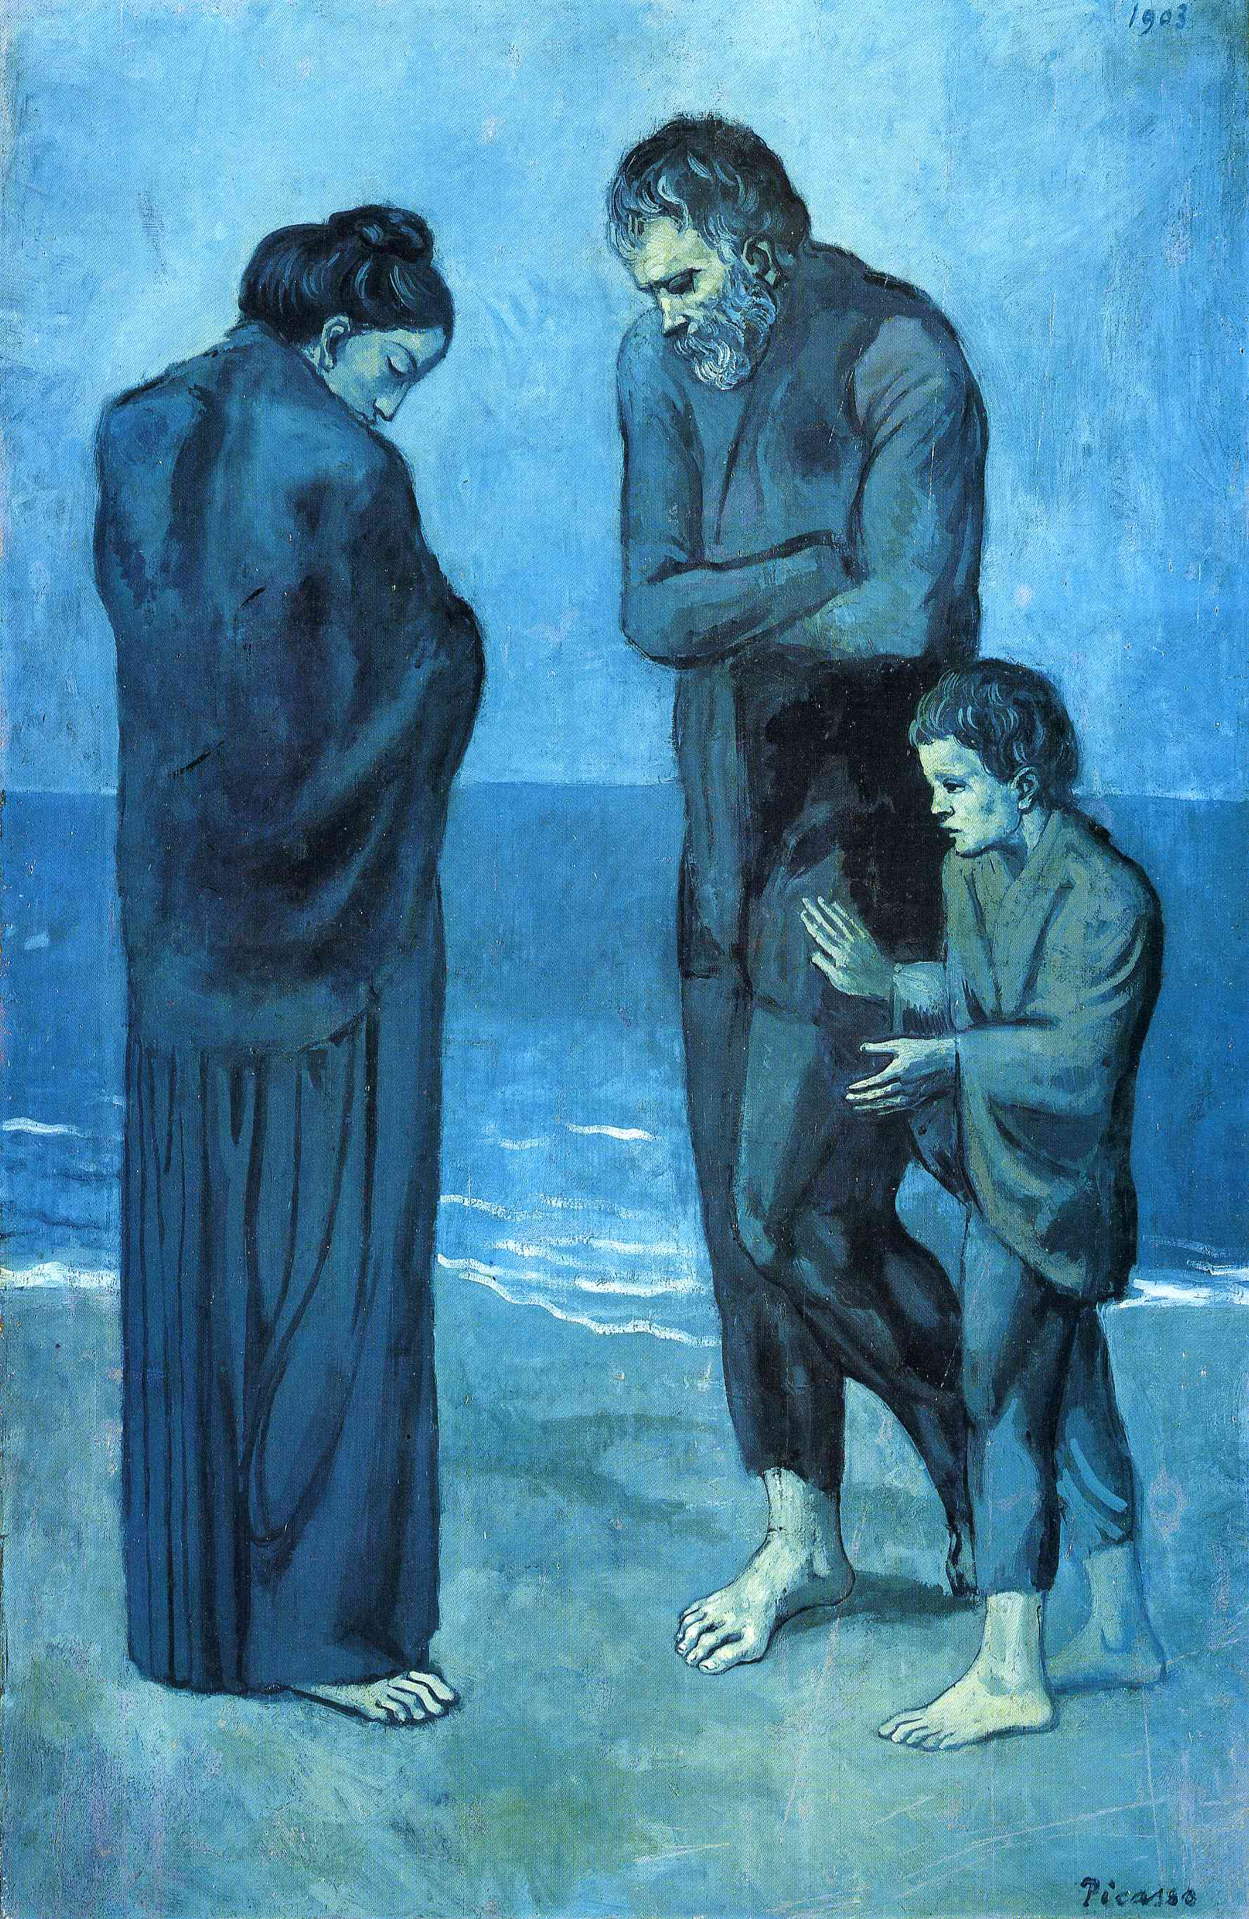
Blue Period
(1901-1904)
In the Blue Period, (1901-1904) Picasso’s paintings featured lots of blue and green and showed sad scenes, such as a struggling blind man and beggars.
Self Portrait, 1901
The Tragedy, 1903

Slide 7
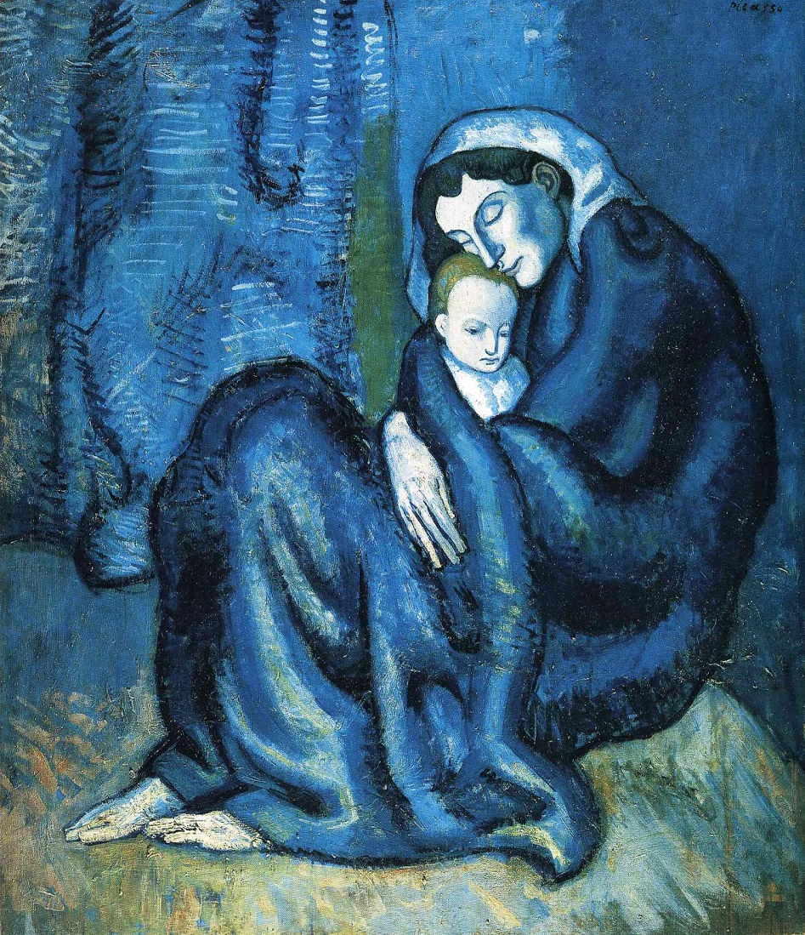
Blue Period
Some people really liked Picasso’s blue paintings. While others, like Picasso’s father, thought they were too strange and upsetting.
This means the paintings were controversial.
Mother and Child, 1902

Slide 8
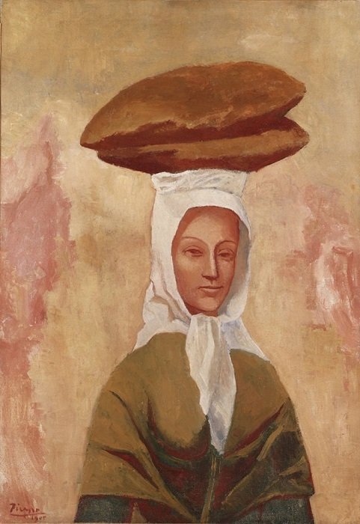
1904
Picasso moved permanently to Paris, and met an artist and model, and fell in love.
Questions for you!
?
What do you notice about this painting that’s different from the paintings in the blue period?
How does this painting make you feel?
Woman with Loaves, 1906
Notes:
Colors and expression on woman’s face.

Slide 9
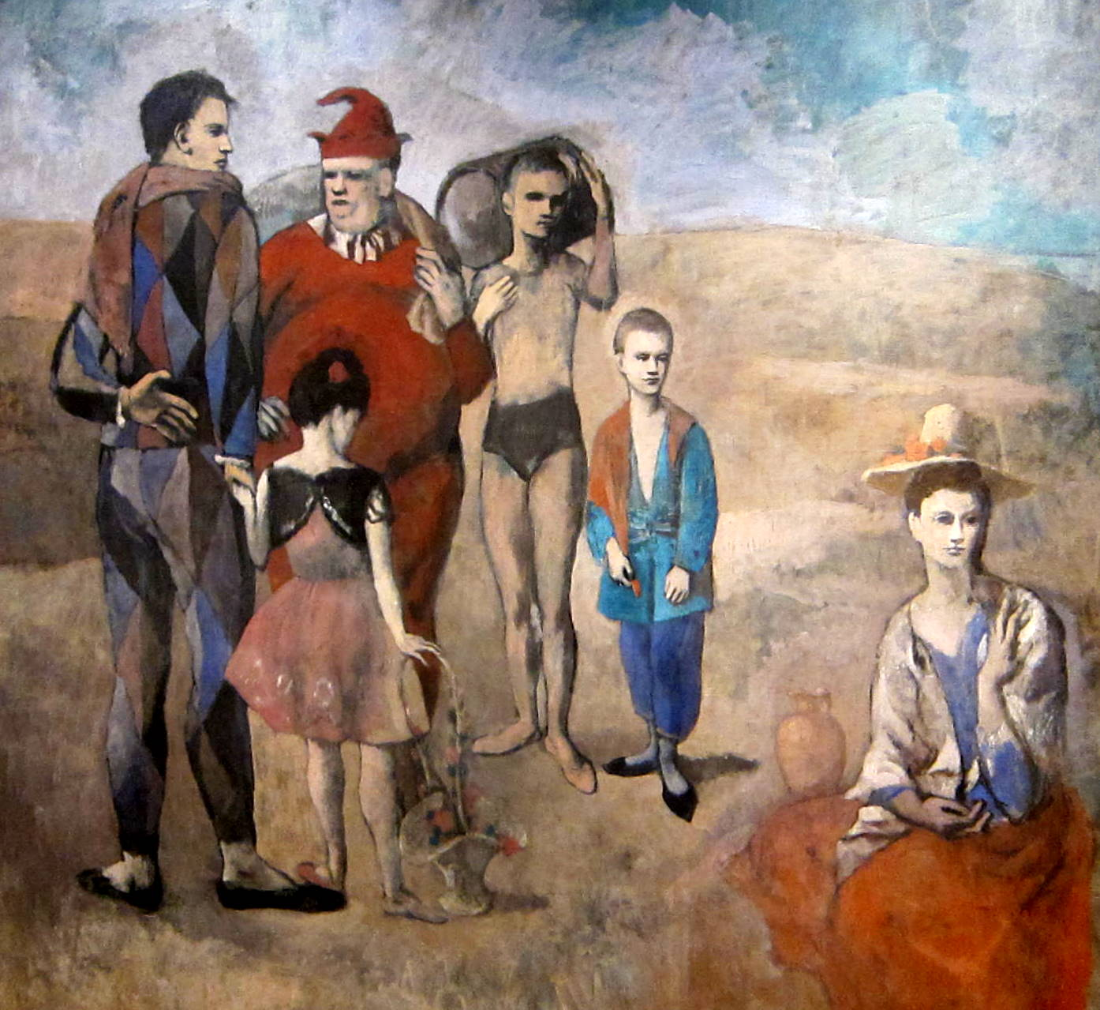
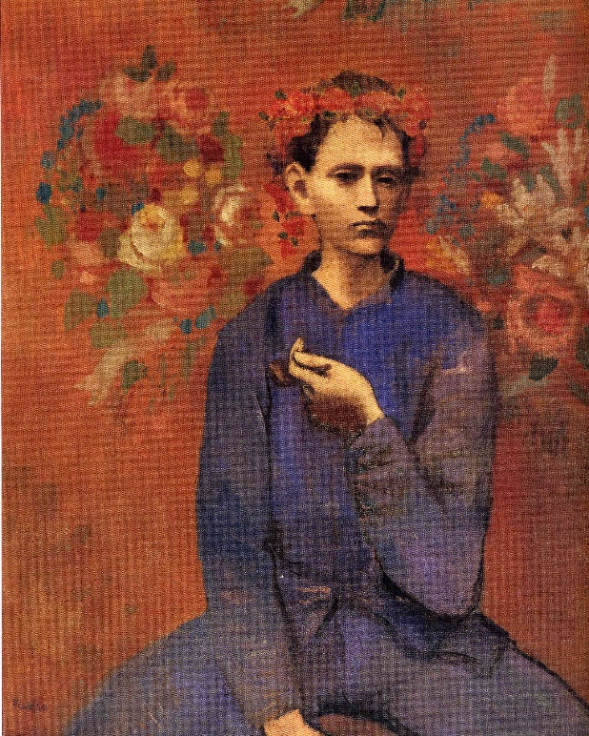
Rose Period
In the Rose Period (1904-1906), Picasso’s paintings featured pink and orange colors. He painted circus people, clowns and portraits.
A Boy with Pipe,
1905
Family of Saltimbanques, 1905

Slide 10
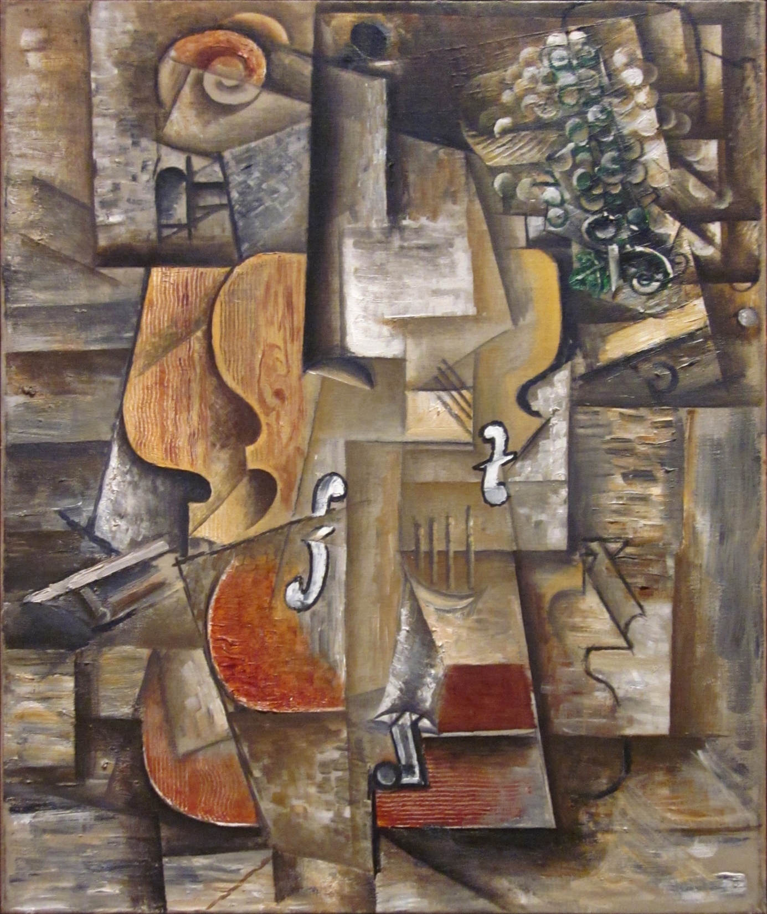
Cubism
In 1907, Picasso and his friend, Georges Braque, tried out a new idea.
They painted things that looked broken.
This style is called Cubism.
It is painted as if time is ever changing.
?
Question
for you!
What do you see?
Violin and Grapes, 1912
Notes:
Abstraction is the lack of representation. It is about the experience you get.

Slide 11
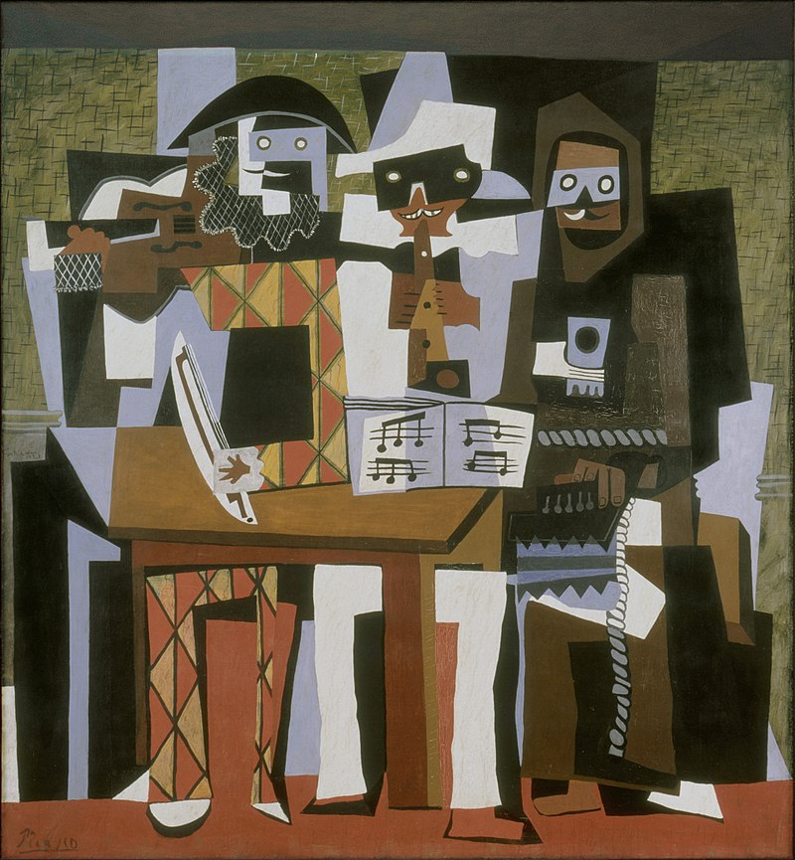
?
Questions
for you!
What do you see?
What do you think the name of this piece is?

Slide 12
Cubism
The Three Musicians, 1921
Picasso liked to tell stories with his artwork.
This painting is Picasso and two friends playing music.

Slide 13
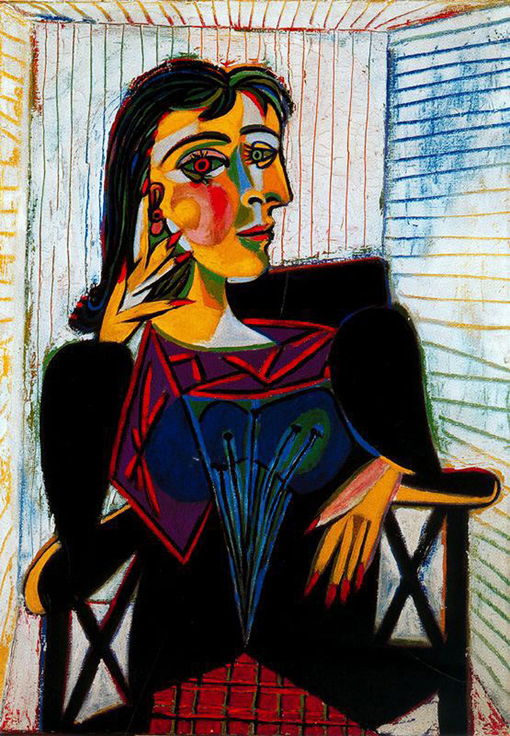
Pablo Picasso was like the weather— changing all the time.
His art style developed and changed from realistic type paintings to more abstract.

Slide 14
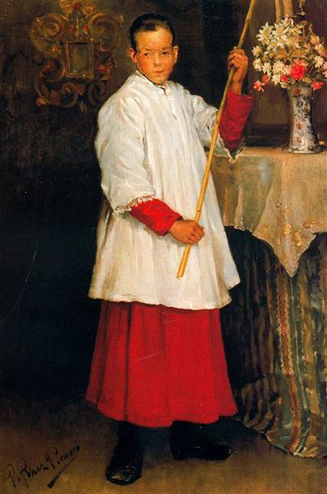
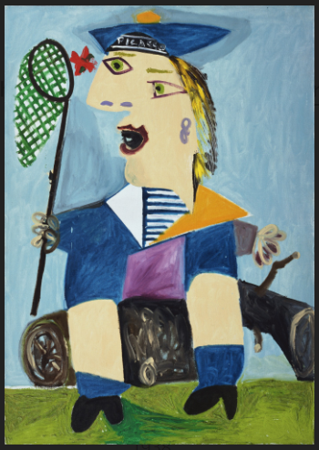
Abstract vs.
Realism
ABSTRACT art uses your imagination to create it, and to understand it.
While REALISM is art that looks just as it might in real life.
The Alter Boy, 1896
Boy in Sailor Suit with Butterfly Net, 1938
Notes:
Abstraction is the lack of representation. It is about the experience you get.

Slide 15
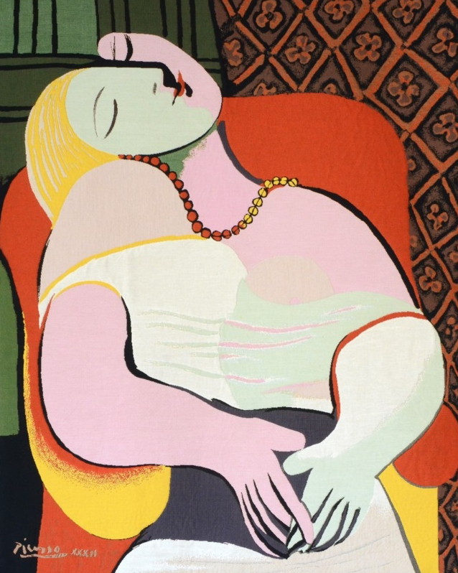
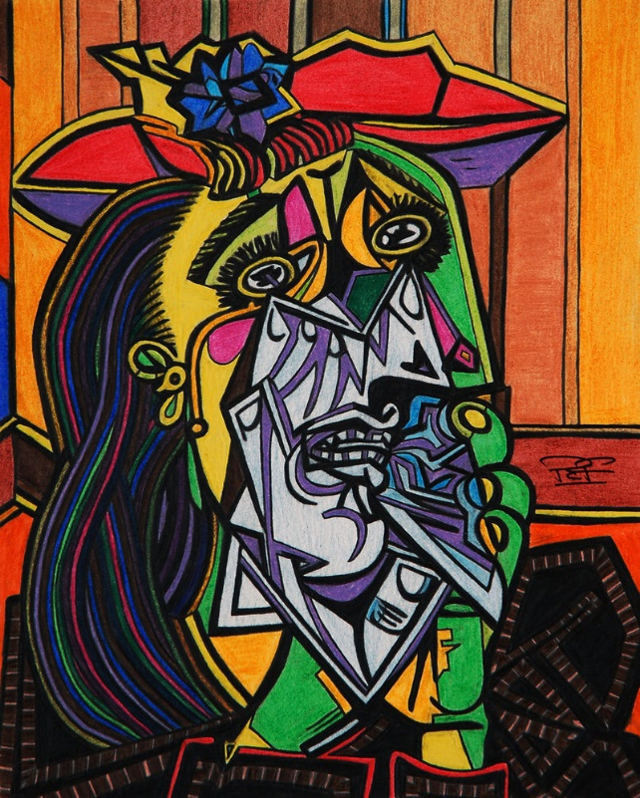
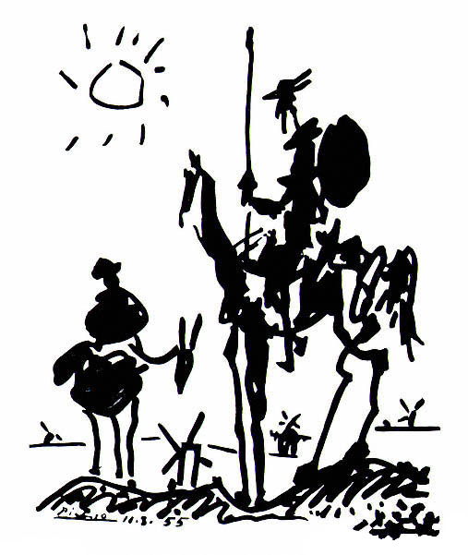
Fun Facts about Pablo Picasso
What was Picasso’s favorite sport to watch?
Football
Bullfighting
Gymnastics
TRUE or FALSE
Picasso sometimes mixed expensive French perfume into his oil paints to attract more buyers.
Picasso had a pet…
Bird
Bull
Dog
B
F
C
Le Via, 1932
Weeping Woman, 1937
Don Quixote, 1955
Notes:
Answer is B: Bullfighting
False. He didn’t need help finding people to buy his work
Answer is C: His full middle name was, Diego Jose Francisco de Paula Juan Nepomuceno Maria de los Remedios Cipriano de la Santisima Trinidad Ruiz y Picasso
Picasso had a pet Dachshund named Lump

Slide 16
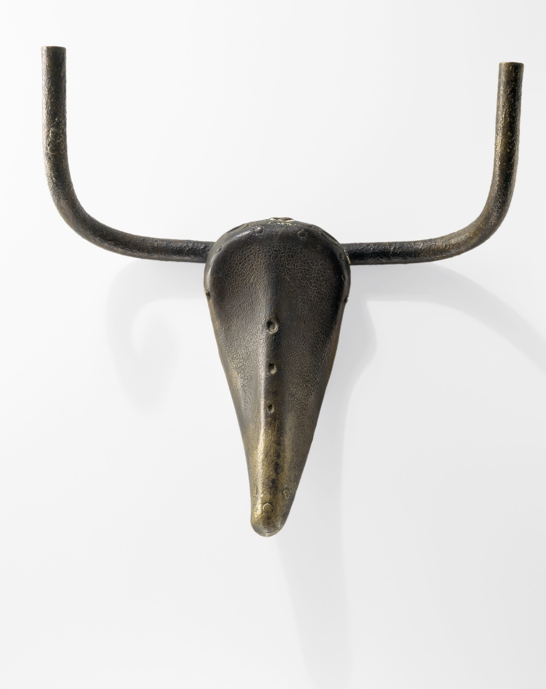
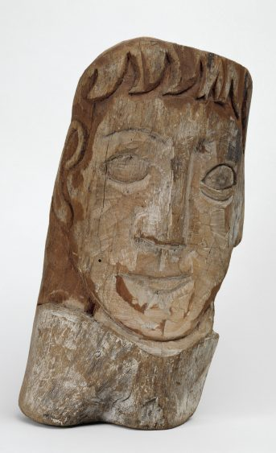
Throughout his career, Picasso liked to shock and surprise people.
He believed art was magical. When he drew and painted, he let his mind wander, and his feelings and imagination run free.
The total number of artworks he produced has been estimated at 50,000, comprising 1,885 paintings; 1,228 sculptures; 2,880 ceramics, roughly 12,000 drawings.
Bulls Head, 1942

Slide 17
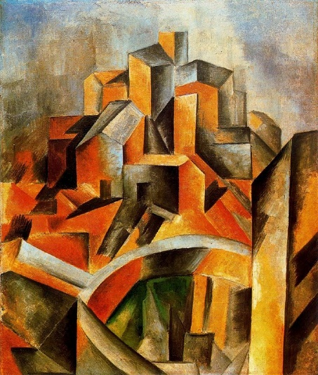
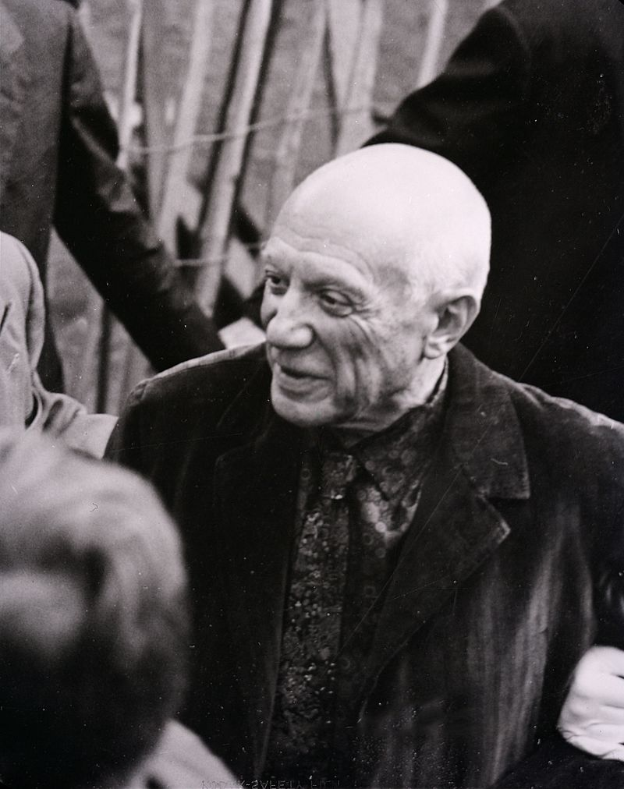
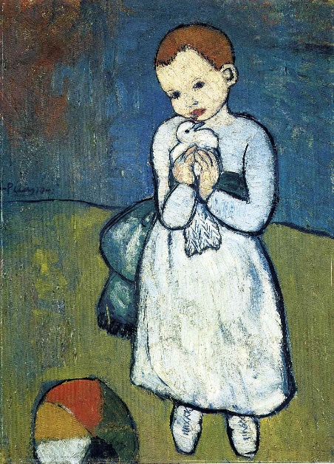
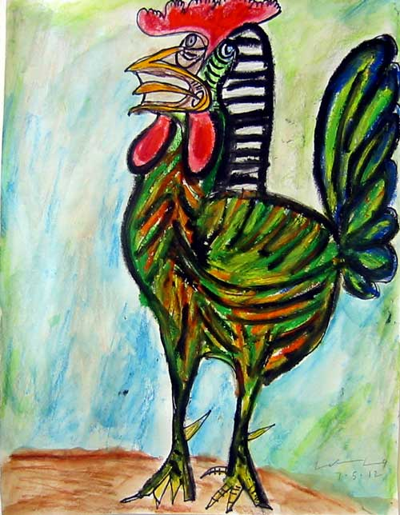
End of Life
Pablo was a famous and successful living artist. People would wait outside his home and studio to meet him. Some days he would open his studio and talk to people. Other days he wanted to stay in bed.
Pablo created art until the very end of his life. He drew in his sketchbook hours before passing away. He was 92.

Slide 18
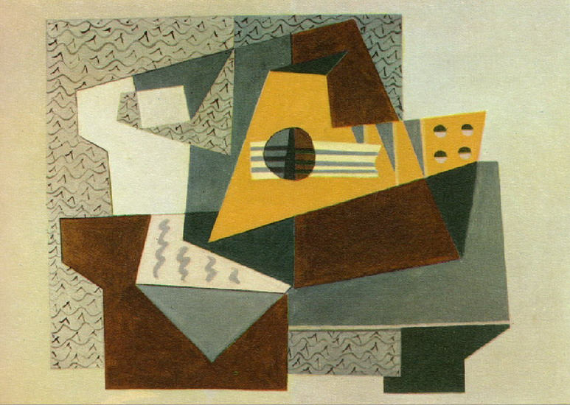
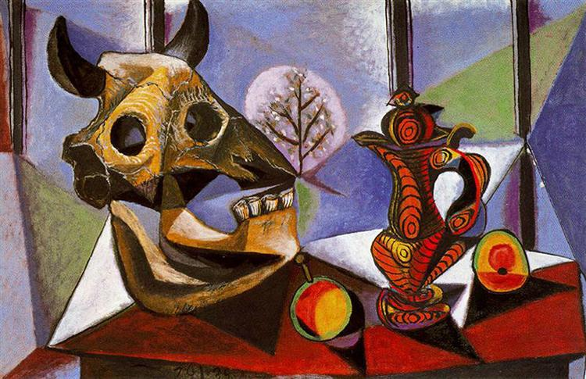
Our Project’s
Inspiration
Still Life with Bull Skull, 1939
Guitare, 1924

Slide 19
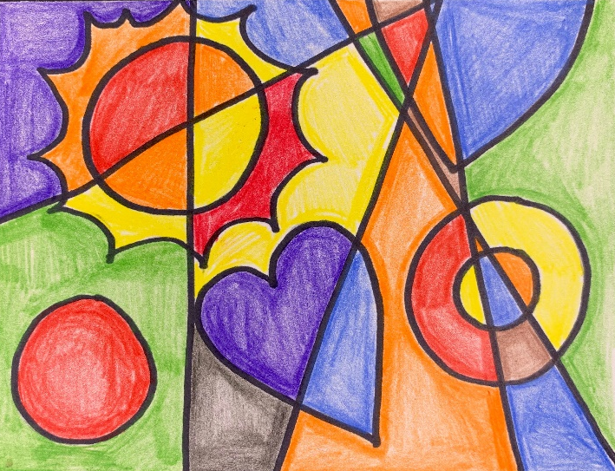
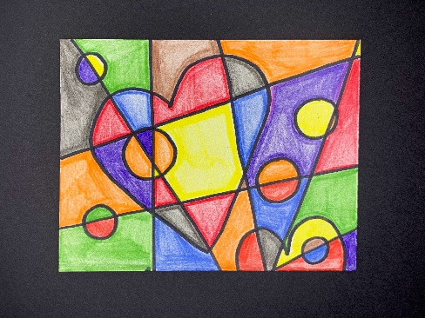
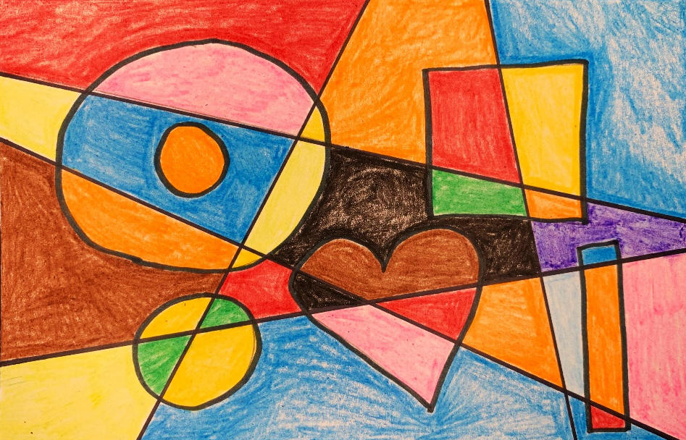
Cubist Shapes
Art Supplies:
4.25” x 5.5” Cardstock (Grades 3-5)
5.5” x 8.5” Cardstock (K-2)
Fine black marker
Ruler (Grades 3-5)
Pencil & eraser
Crayons
Scrap paper for underneath
Art Fundamentals:
Cubism
Variety in shapes
Use of line

Slide 20

Put your name
on your paper

Slide 21
Think about what kinds of shapes you might
want to draw on your paper.
The shapes should be something you can fill in.

Slide 22
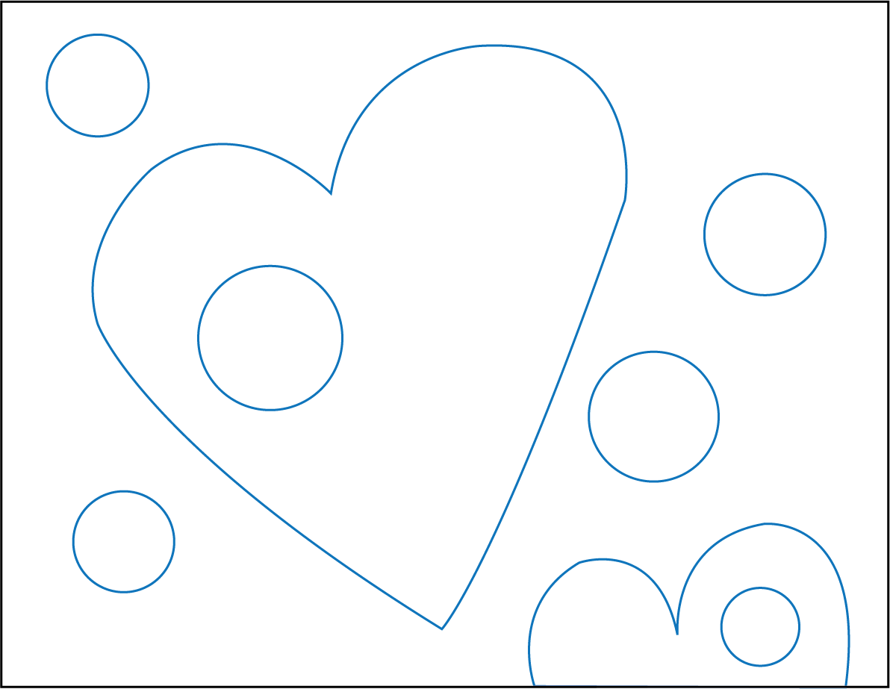

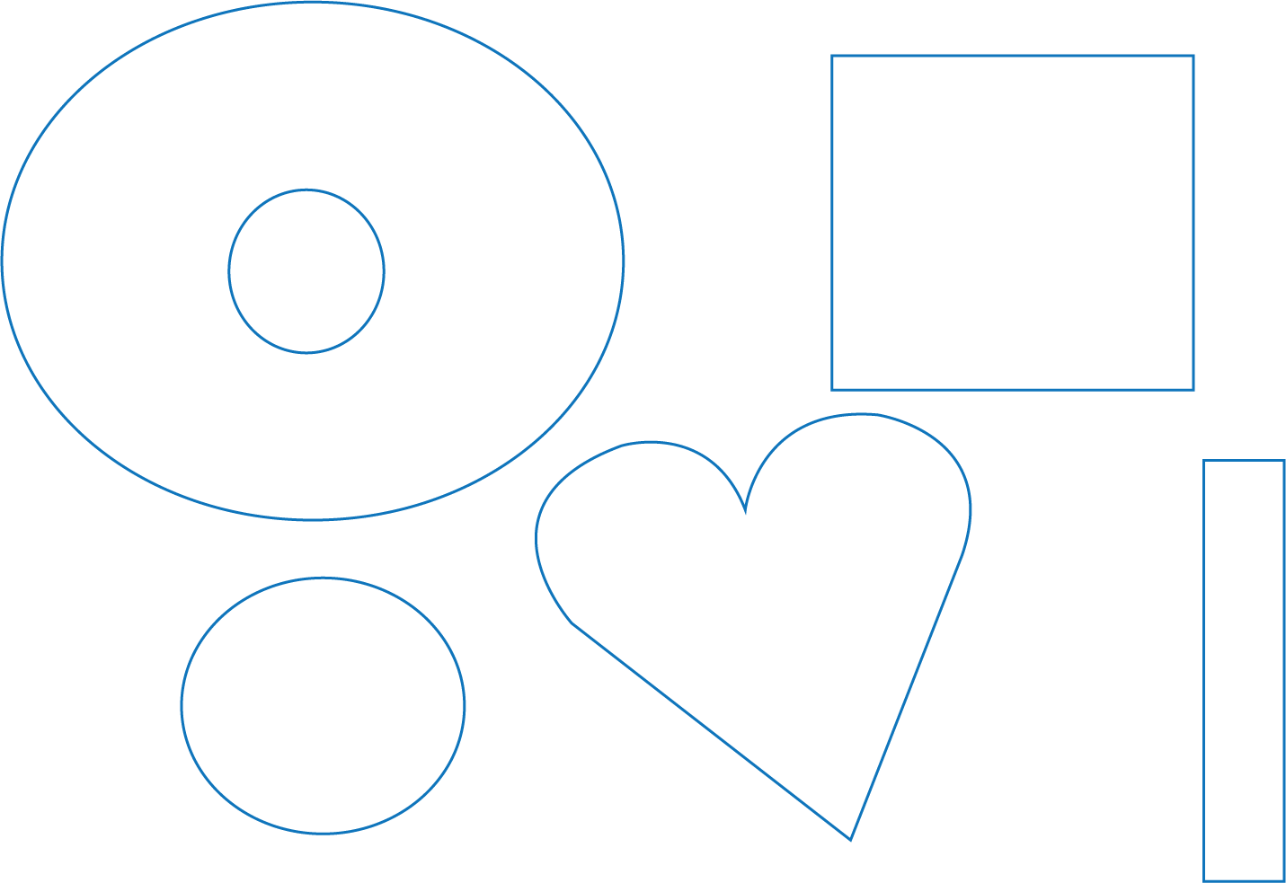
1.
Draw several shapes
Grades 3-5
Grades K-2
Then move on to going over your shape lines with marker.
Then move on to step 2.

Slide 23

Grades 3-5
2.
Draw 4-6 lines using your ruler.
3.
Draw over the shape lines with black marker.

Slide 24

Time to color in the new shapes you made with the lines.
Try to use different colors in each shape to break it up even further.

Slide 25


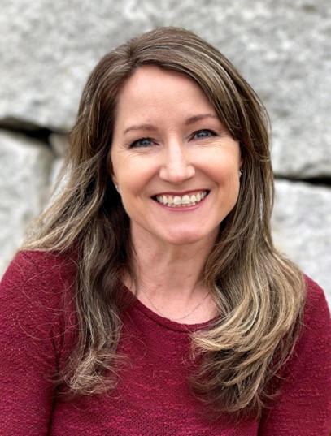
I HOPE YOU ENJOYED THIS LESSON
Stay Curious!
Rachel Allen Dillon
www.RachelDillon.com

Slide 26
References
https://kidskonnect.com/people/pablo-picasso/
https://www.youtube.com/watch?v=RlNf5XZDcQs
https://www.pablo-ruiz-picasso.net/theme-guitar.php
Pablo Picasso by Linda Lowery
Getting to Know the Worlds Greatest Artists - Pablo Picasso by Mike Venezia
https://www.youtube.com/watch?v=POKhJNFlQYE

