Slide 1
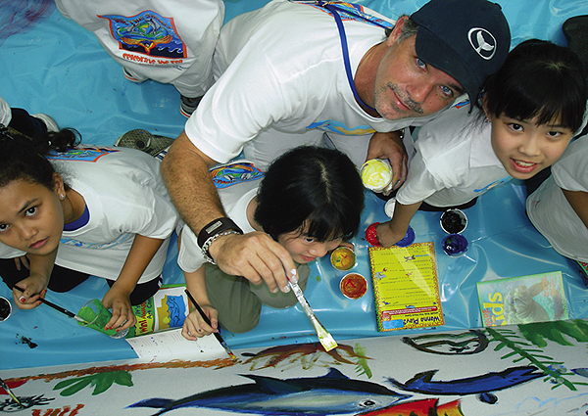
Wyland
Robert wyland
1956-Present

Slide 2
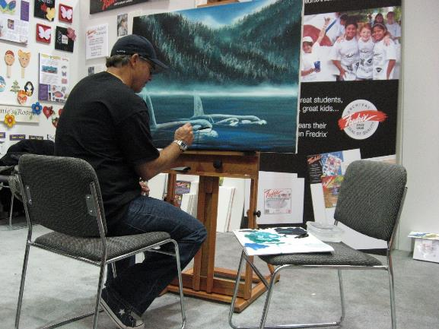
Robert Wyland or just, “Wyland”
From Detroit, Michigan
His parents worked in the auto industry
His mom raised him and his three brothers by herself
Inspired by Jacque Cousteau and Rachel Carson
Thought he’d become a marine scientist
Graduated with a fine art degree from the College of Creative Studies in Detroit, Michigan

Slide 3
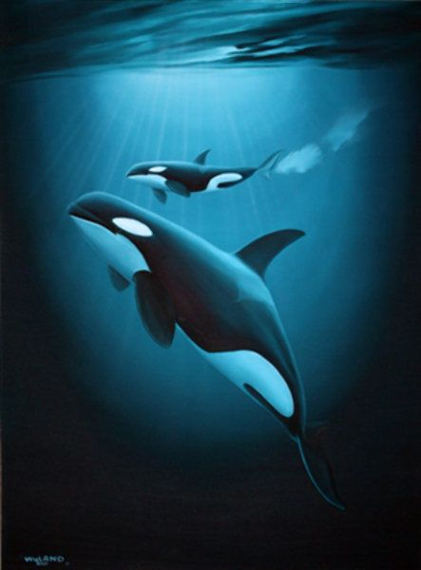
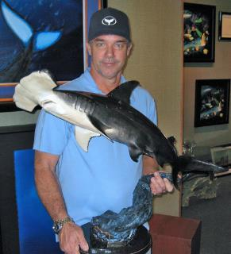
Inspiration
When Wyland was 14 years old he traveled with his family from Detroit, MI to Laguna Beach, CA. It was the first time he saw the ocean.

Slide 4
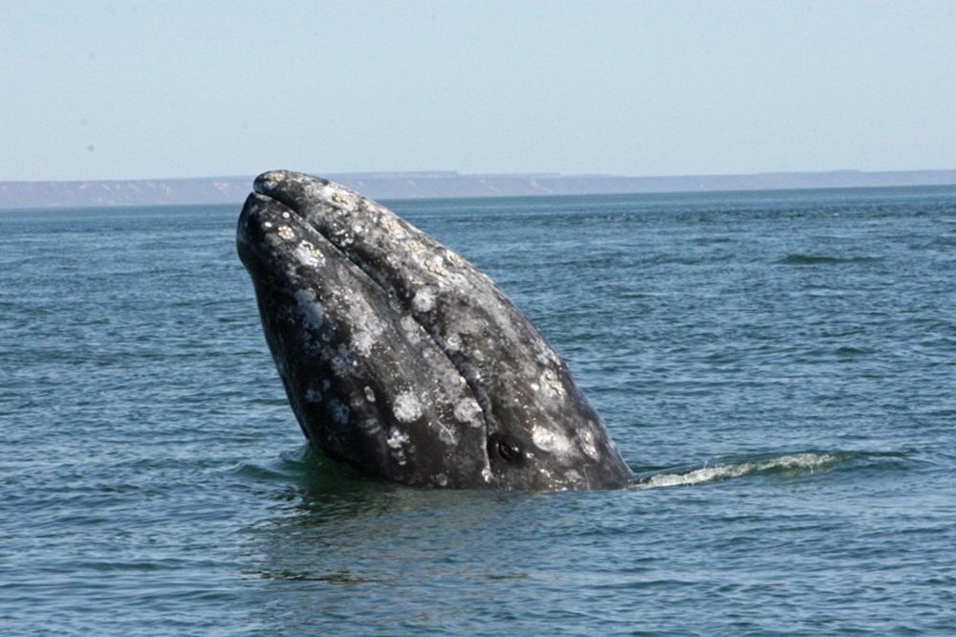
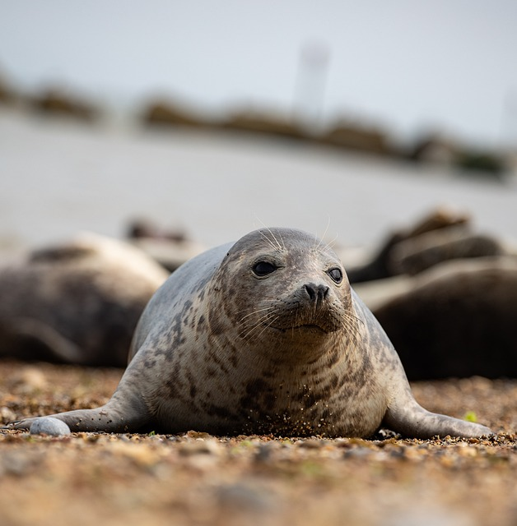
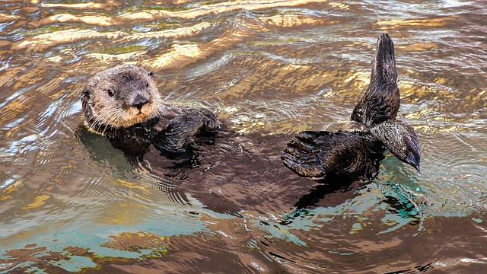
What marine animal do you think shocked and inspired Wyland during his trip to Laguna Beach?
Gray Whale
Harbor Seal
Sea Otter
Notes:
Gray whales were migrating at the time and the vision inspired his love for marine life further.
Image by <a href="https://pixabay.com/users/christels-3741991/?utm_source=link-attribution&utm_medium=referral&utm_campaign=image&utm_content=3194453">Christel SAGNIEZ</a> from <a href="https://pixabay.com//?utm_source=link-attribution&utm_medium=referral&utm_campaign=image&utm_content=3194453">Pixabay</a>
Image by <a href="https://pixabay.com/users/theotherkev-9436196/?utm_source=link-attribution&utm_medium=referral&utm_campaign=image&utm_content=6588055">Kev</a> from <a href="https://pixabay.com//?utm_source=link-attribution&utm_medium=referral&utm_campaign=image&utm_content=6588055">Pixabay</a>

Slide 5
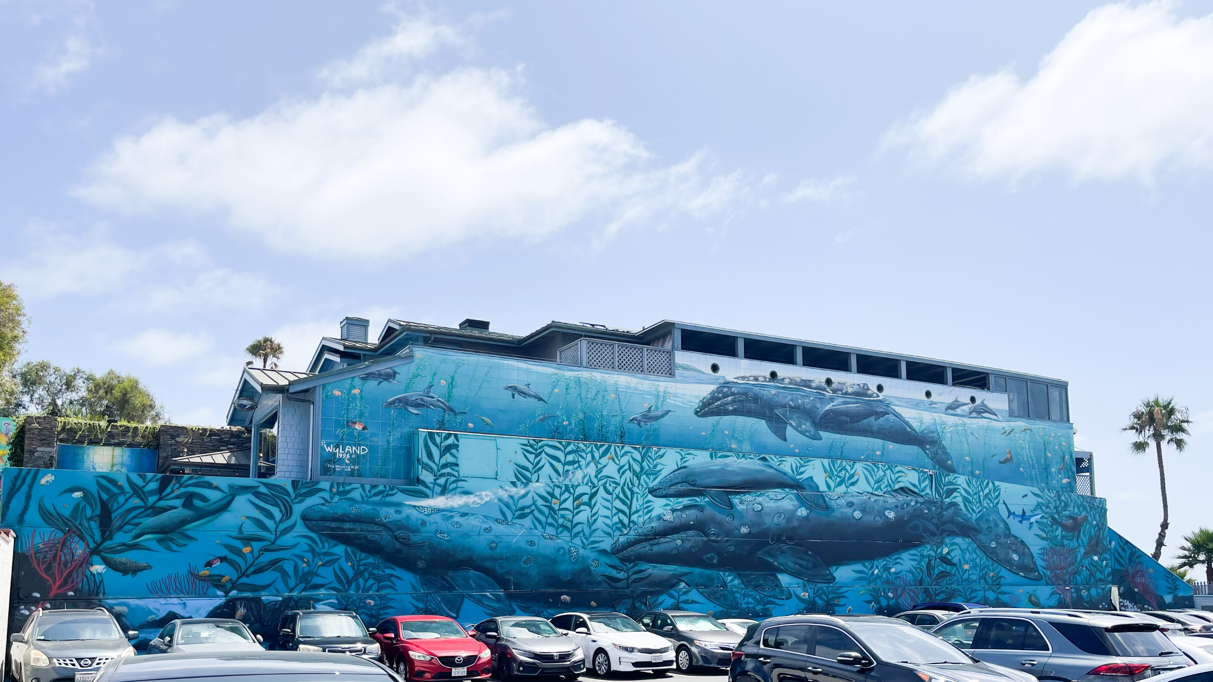
Life-Size Whales
He moved to California in the late 1970’s.
By the time Wyland was 41, 25 art galleries carried his work.
Most of his personal galleries are run by family.
He has created a multi-million-dollar industry.
He splits his time between Hawaii, California, and Florida.

Slide 6
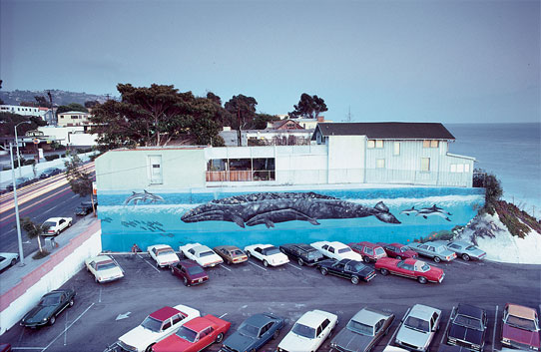
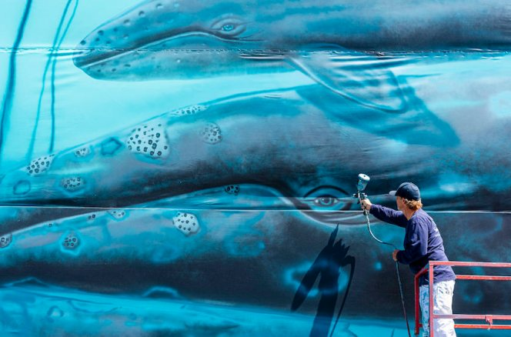
Thinking BIG
Wyland utilizes his career as an artist, to raise awareness on the preservation of marine life.
It’s estimated that his public murals are viewed by more than a billion people every year around the world.
“Gray Whale and Calf”
Acrylic, 1981
This was Wyland’s first life size mural painted on the side of the Hotel Laguna in Laguna Beach, CA.
Recreation of his first mural
on the wall outside his Laguna Beach, CA gallery in 2019

Slide 7
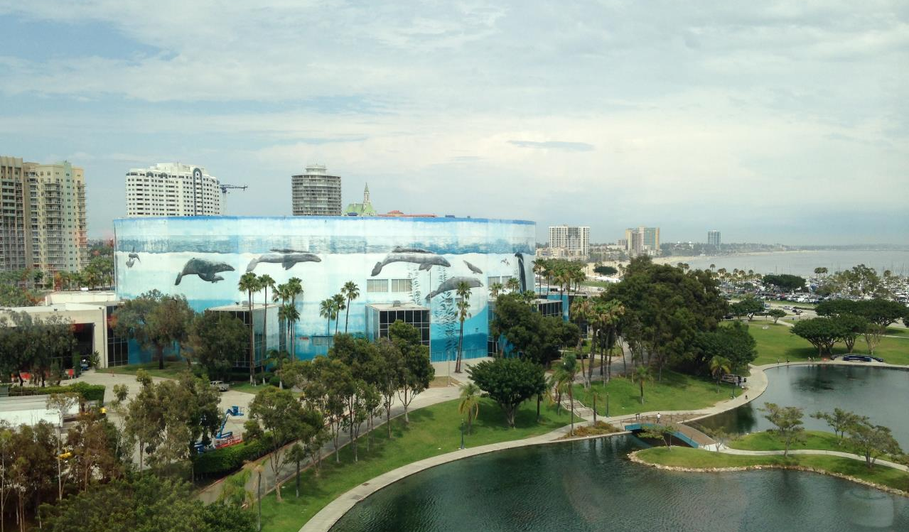
100 Whaling Walls
On average, Wyland’s mural’s take about 100 gallons of acrylic paint.
It took him 27 years to complete 100 whaling walls around the globe – 1981-2008. Now he’s restoring some of them and added a new one in 2019 to reach 101 murals.
Whale Wall #33 Long Beach Convention Center,
Long Beach, California
Notes:
"Art can change the world," he said, "especially on a grand scale."

Slide 8
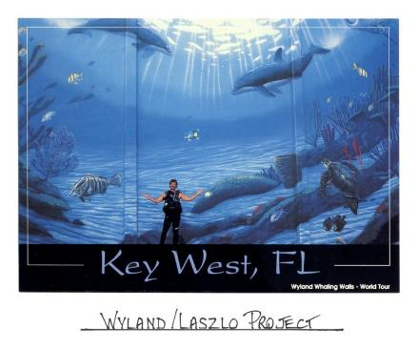
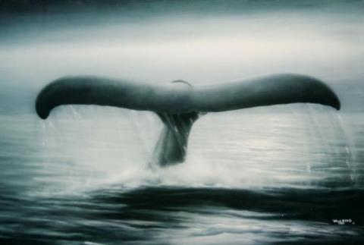
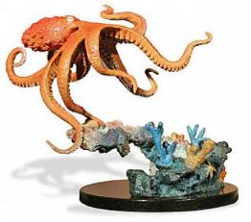
Utilizing different mediums and scale
Wyland applies his talent to all mediums. From giant true-to-life sized murals, to capturing the natural grace of marine life in sculpture.
With his marketing genius comes awareness. His art and name go hand-in-hand with environmental conservation.

Slide 9
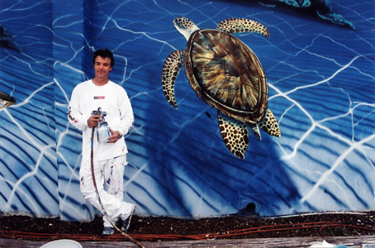
More than just art
In 1993, he founded the Wyland Foundation to help children and families across the United States rediscover the importance of environmentalism through public art programs, classroom science education, and live events.
Since its inception, the organization has worked directly with more than one million children.
"Cleaning up the Earth is a messy job, but somebody's got to do it," said Wyland, 52.

Slide 10
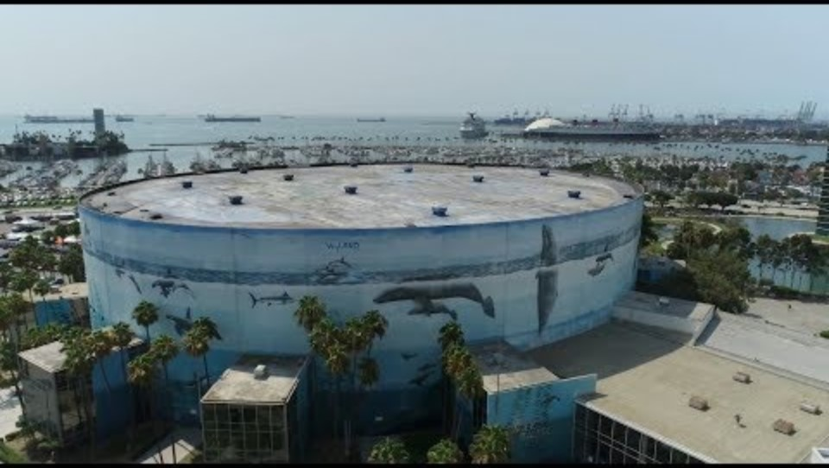

Slide 11



Put your name on
your paper

Slide 12
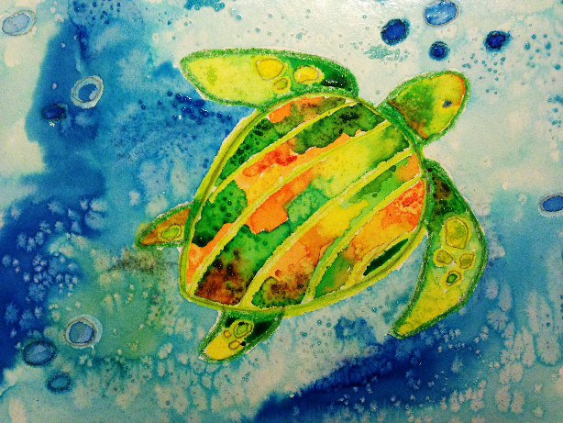
Sea Turtle
Art Supplies:
8.5” x 11” Watercolor paper
Watercolor palette or liquid watercolor paint
Crayons
Salt
Paint palette
Paper towels
Water cups
Paintbrush
Pencil & eraser
Scrap paper for underneath
Art Fundamentals:
Resistance painting
Chemical reaction: salt & water
Texture

Slide 13

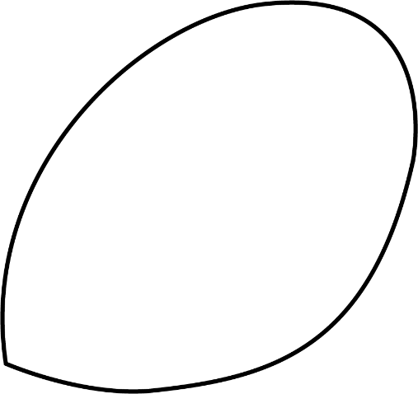
1
2
Let’s draw a sea turtle together!
Use pencil lightly
Add the shell

Slide 14


3
4
Put lines on the shell
Add front flippers

Slide 15
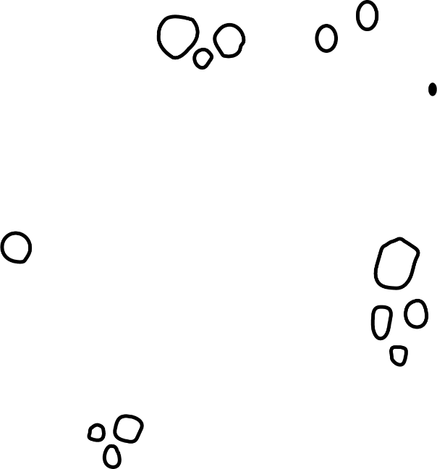

5
6
Add back flippers
Add the eye, circles on the flippers, and little oxygen bubbles

Slide 16
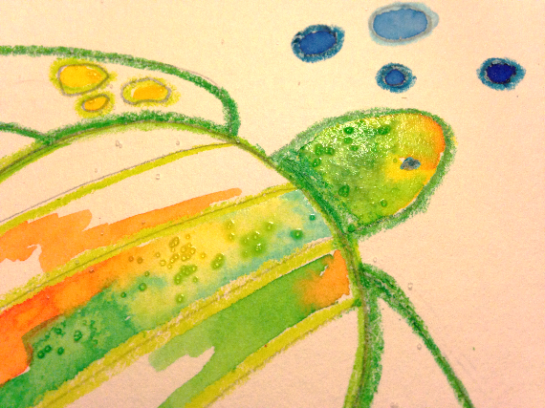
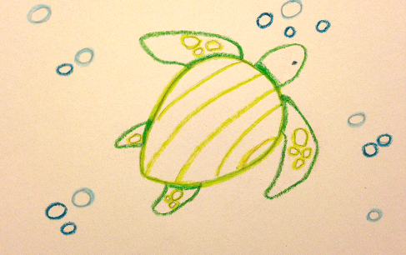
Add more bubbles. Go over your pencil lines with crayons. You can choose the colors you want your turtle and bubbles to be.
DO NOT color in the turtle, only outline.
Begin to watercolor paint. While the paint is still wet, sprinkle salt on the paint.

Slide 17


Slide 18
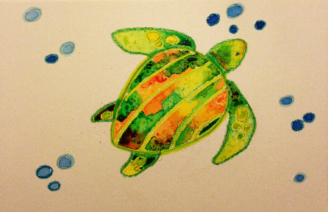
Watercolor Tips
It’s fun to mix paint on the paper. Sometimes it takes a small drop of color placed on another to create a swirl of new colors.
If you overlap all the colors together you end up with brown.

Slide 19
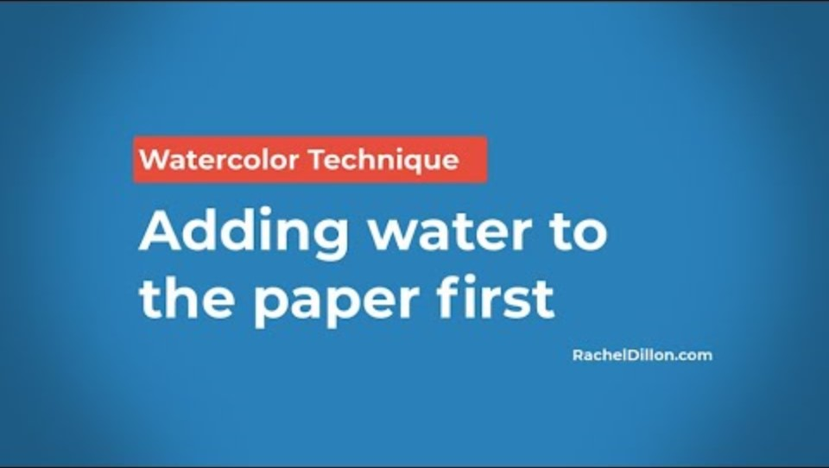

Slide 20
Last Steps
Watercolor the background around the turtle.
Make different blues by adding more blue when the paper has dried a bit or add water on your brush to make it a lighter blue.
Add salt to the wet sections.

Slide 21
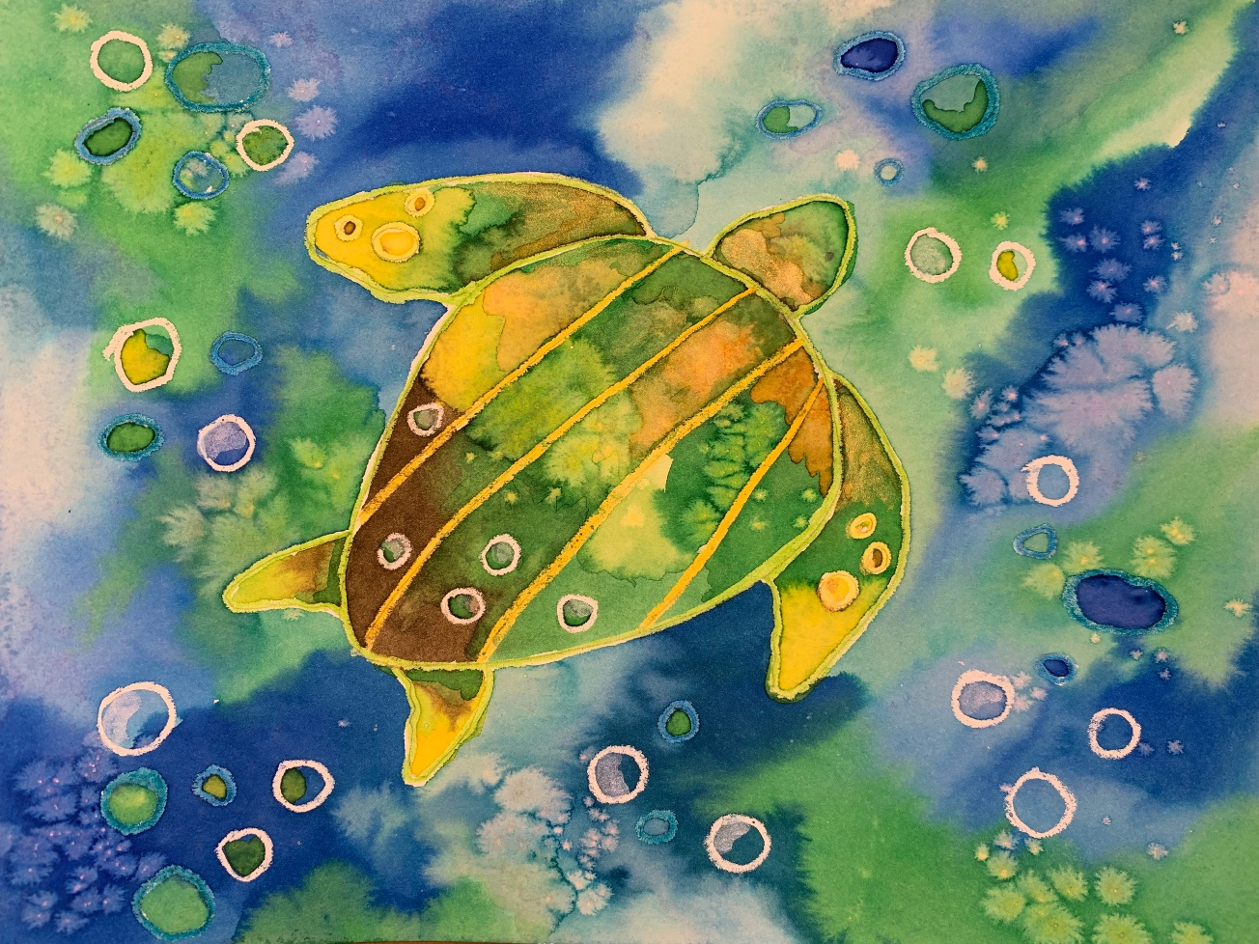
References
Artist Wyland gives Long Beach the world By John Canalis, Staff Writer, http://www.presstelegram.com
Wyland.com
Wylandfoundation.org
https://sanignaciograywhales.org/project/gray-whale-photographs/
https://youtu.be/fnh6MLBPof8?si=OB6guPK6a0WXebMY
https://sevenseasmedia.org/wyland-channelling-environmental-education-into-an-artform/

