Slide 1
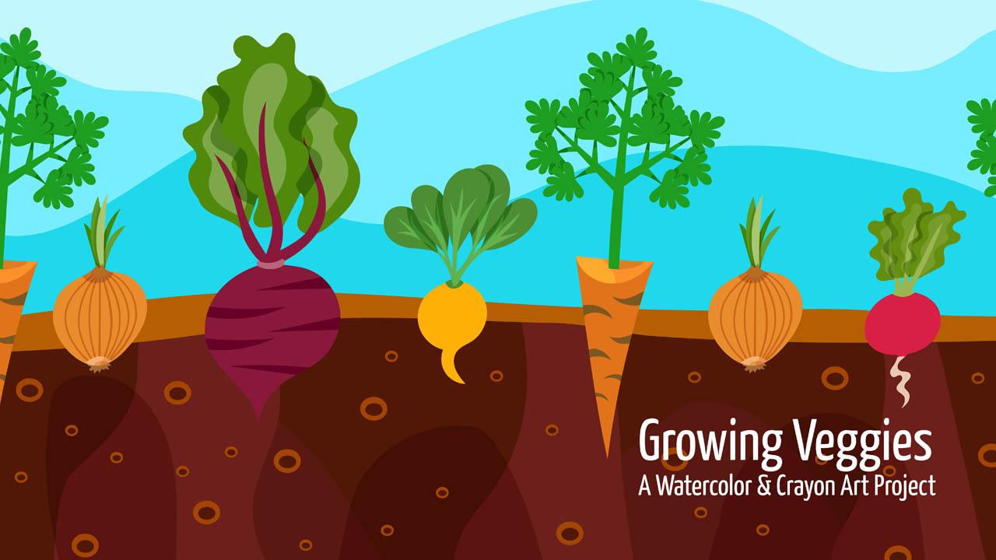
Growing Veggies
A Watercolor & Crayon Piece
Notes:
Frequently an artist creates a piece to share it with a viewer, like you. They use techniques to keep you interested in their creation, so you spend time in the story they tell with their work. They may create something that you’ve never seen or thought of before, or use methods and tools so that things like paint work differently.
We’re going to look at some of these techniques and apply them to our art project today.

Slide 2
Art Techniques
Three – Using three to create a visual balance.
Variety– Makes a piece more interesting.
Perception – becoming aware of things based on a different point of view.
Resistance– How watercolor paint rolls off substances like wax from a crayon and attaches itself to the paper.
Notes:
The ability to see, hear, or become aware of something through the senses

Slide 3

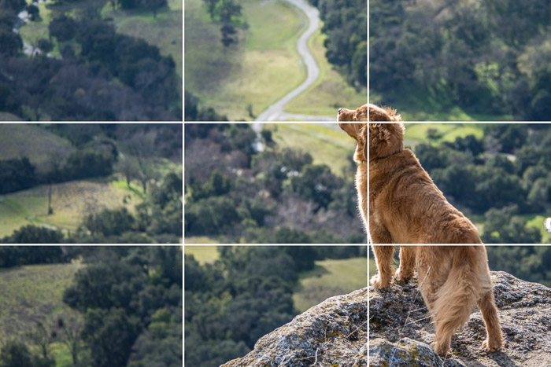
Rule of Three
Studies prove that if you place elements of your artwork along natural lines it becomes more balanced and more comfortable for the viewer.
People’s eyes are usually drawn to one of the intersection points rather than the center of the piece.

Slide 4
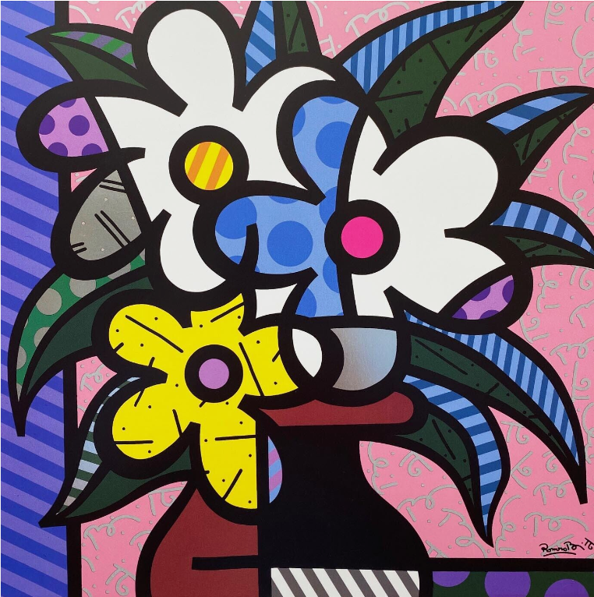
Rule of Odds in Composition
Having an odd number of things in a composition makes things more exciting.
Your eye and brain can't pair things up or group them easily and there’s always one thing left over, which keeps your eyes moving across the page.
Romero Britto
Notes:
Image by <a href="https://pixabay.com/users/deedster-2541644/?utm_source=link-attribution&amp;utm_medium=referral&amp;utm_campaign=image&amp;utm_content=1658814">Deedster</a> from <a href="https://pixabay.com/?utm_source=link-attribution&amp;utm_medium=referral&amp;utm_campaign=image&amp;utm_content=1658814">Pixabay</a>

Slide 5
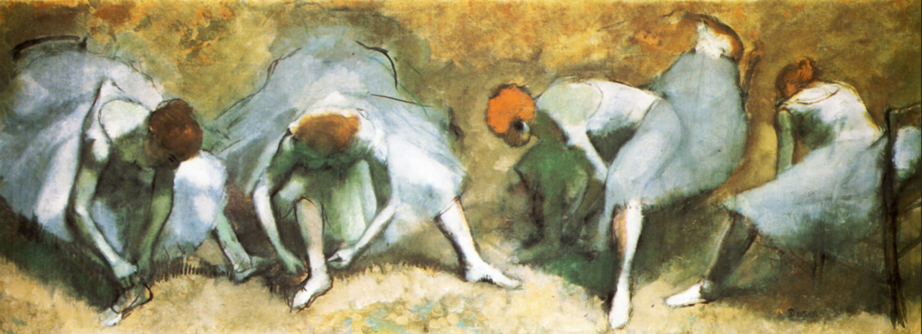

Variety Makes Art Interesting
These four ballerinas are all putting on their ballet slippers, but how are they different?
To keep your composition appealing changing shapes and colors can help.
Edgar Degas - Dancers tying shoes (1883)
Notes:
Edgar Degas Dancers tying shoes (1883)

Slide 6
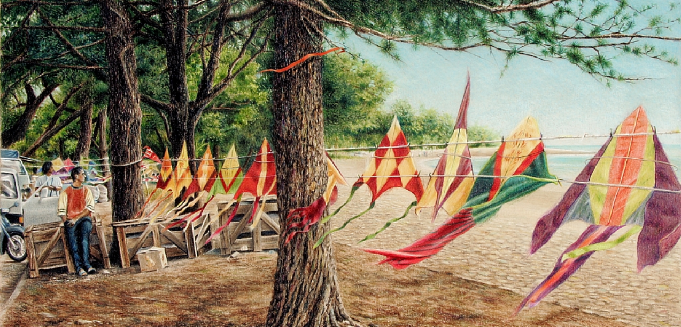
Variety Makes Art Interesting
Variety is achieved by differences in how the elements of art are used. To keep your composition appealing changing shapes and colors can help.
Craig Shillam
Notes:
https://www.craigshillam.com/works/?nav=y&startrec=41
For example, with lines, a combination of thick and thin lines may be more interesting than all thick or all thin lines.

Slide 7

Perception:
If we look at something from another point of view, what we see things differently.
Notes:
If we are on the shore of an ocean we see the water.
When we are under the water we see life.

Slide 8
Perception:
If we look at something from another point of view, what we see things differently.
Notes:
If we are on the shore of an ocean we see the water.
When we are under the water we see life.

Slide 9
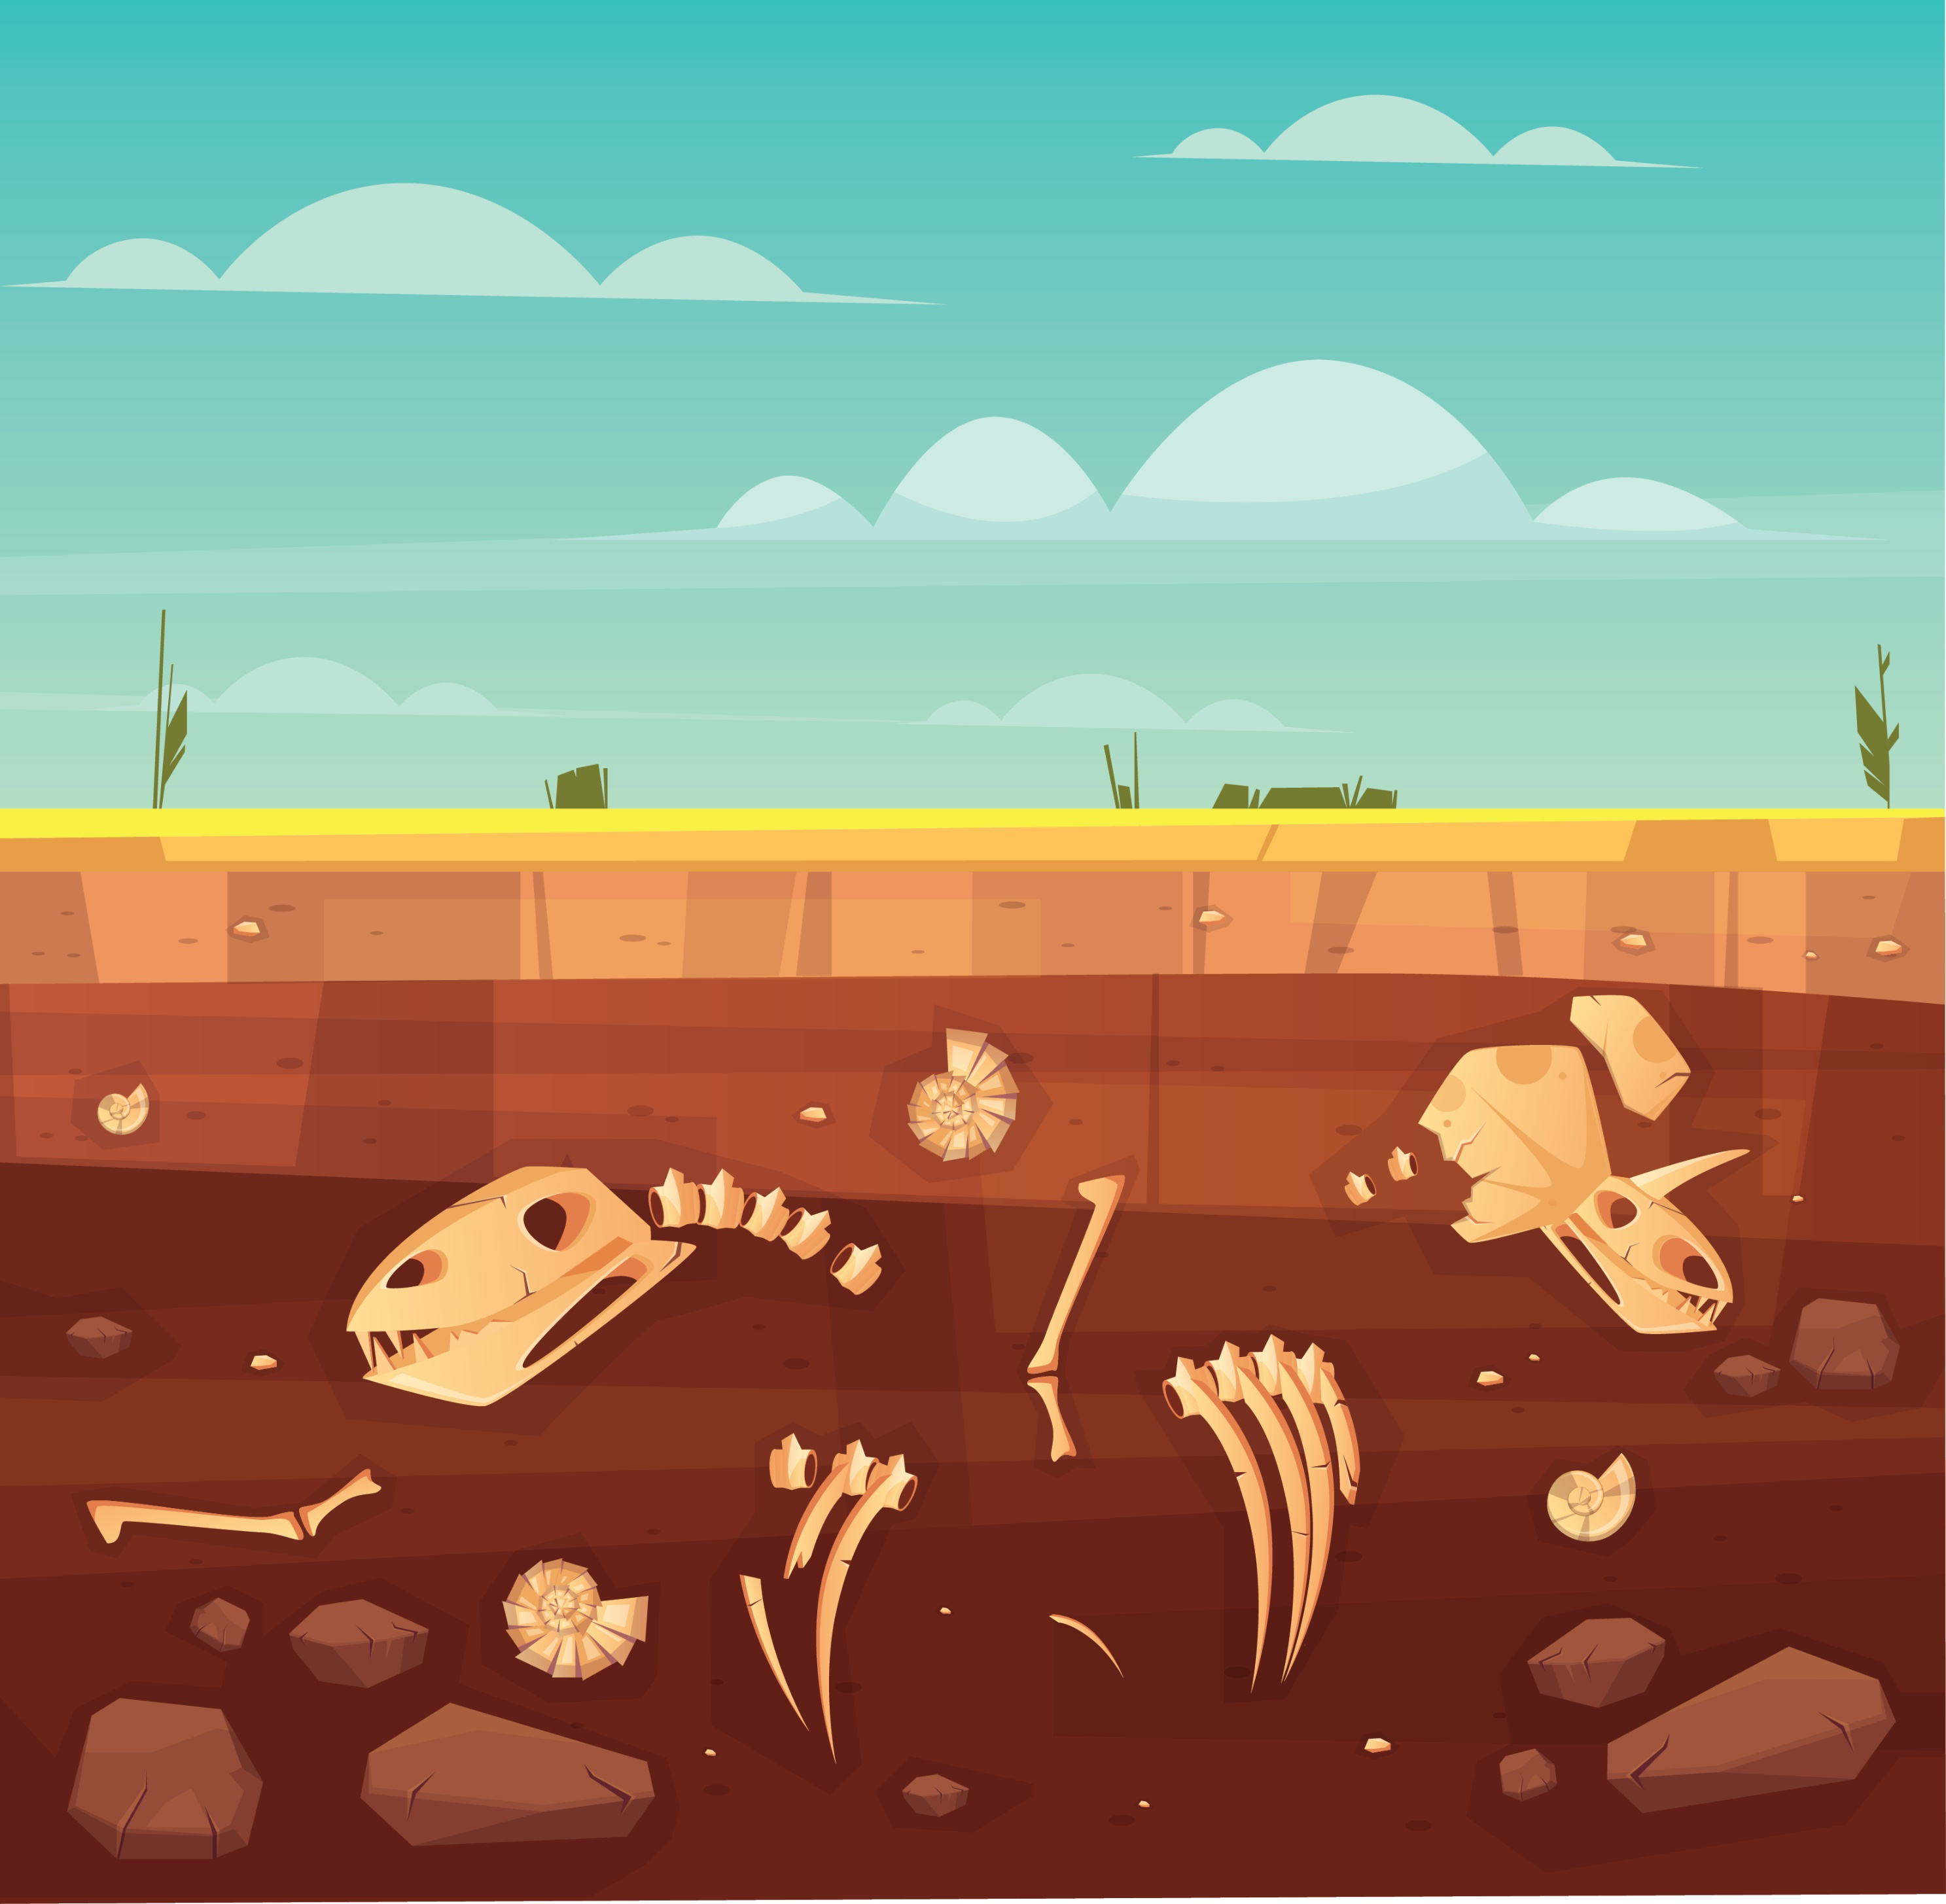
What other things do we not see because it’s below a surface?
Notes:
<a href='https://www.freepik.com/vectors/background'>Background vector created by vectorpouch - www.freepik.com</a>

Slide 10
Notes:
<a href='https://www.freepik.com/vectors/background'>Background vector created by vectorpouch - www.freepik.com</a>

Slide 11
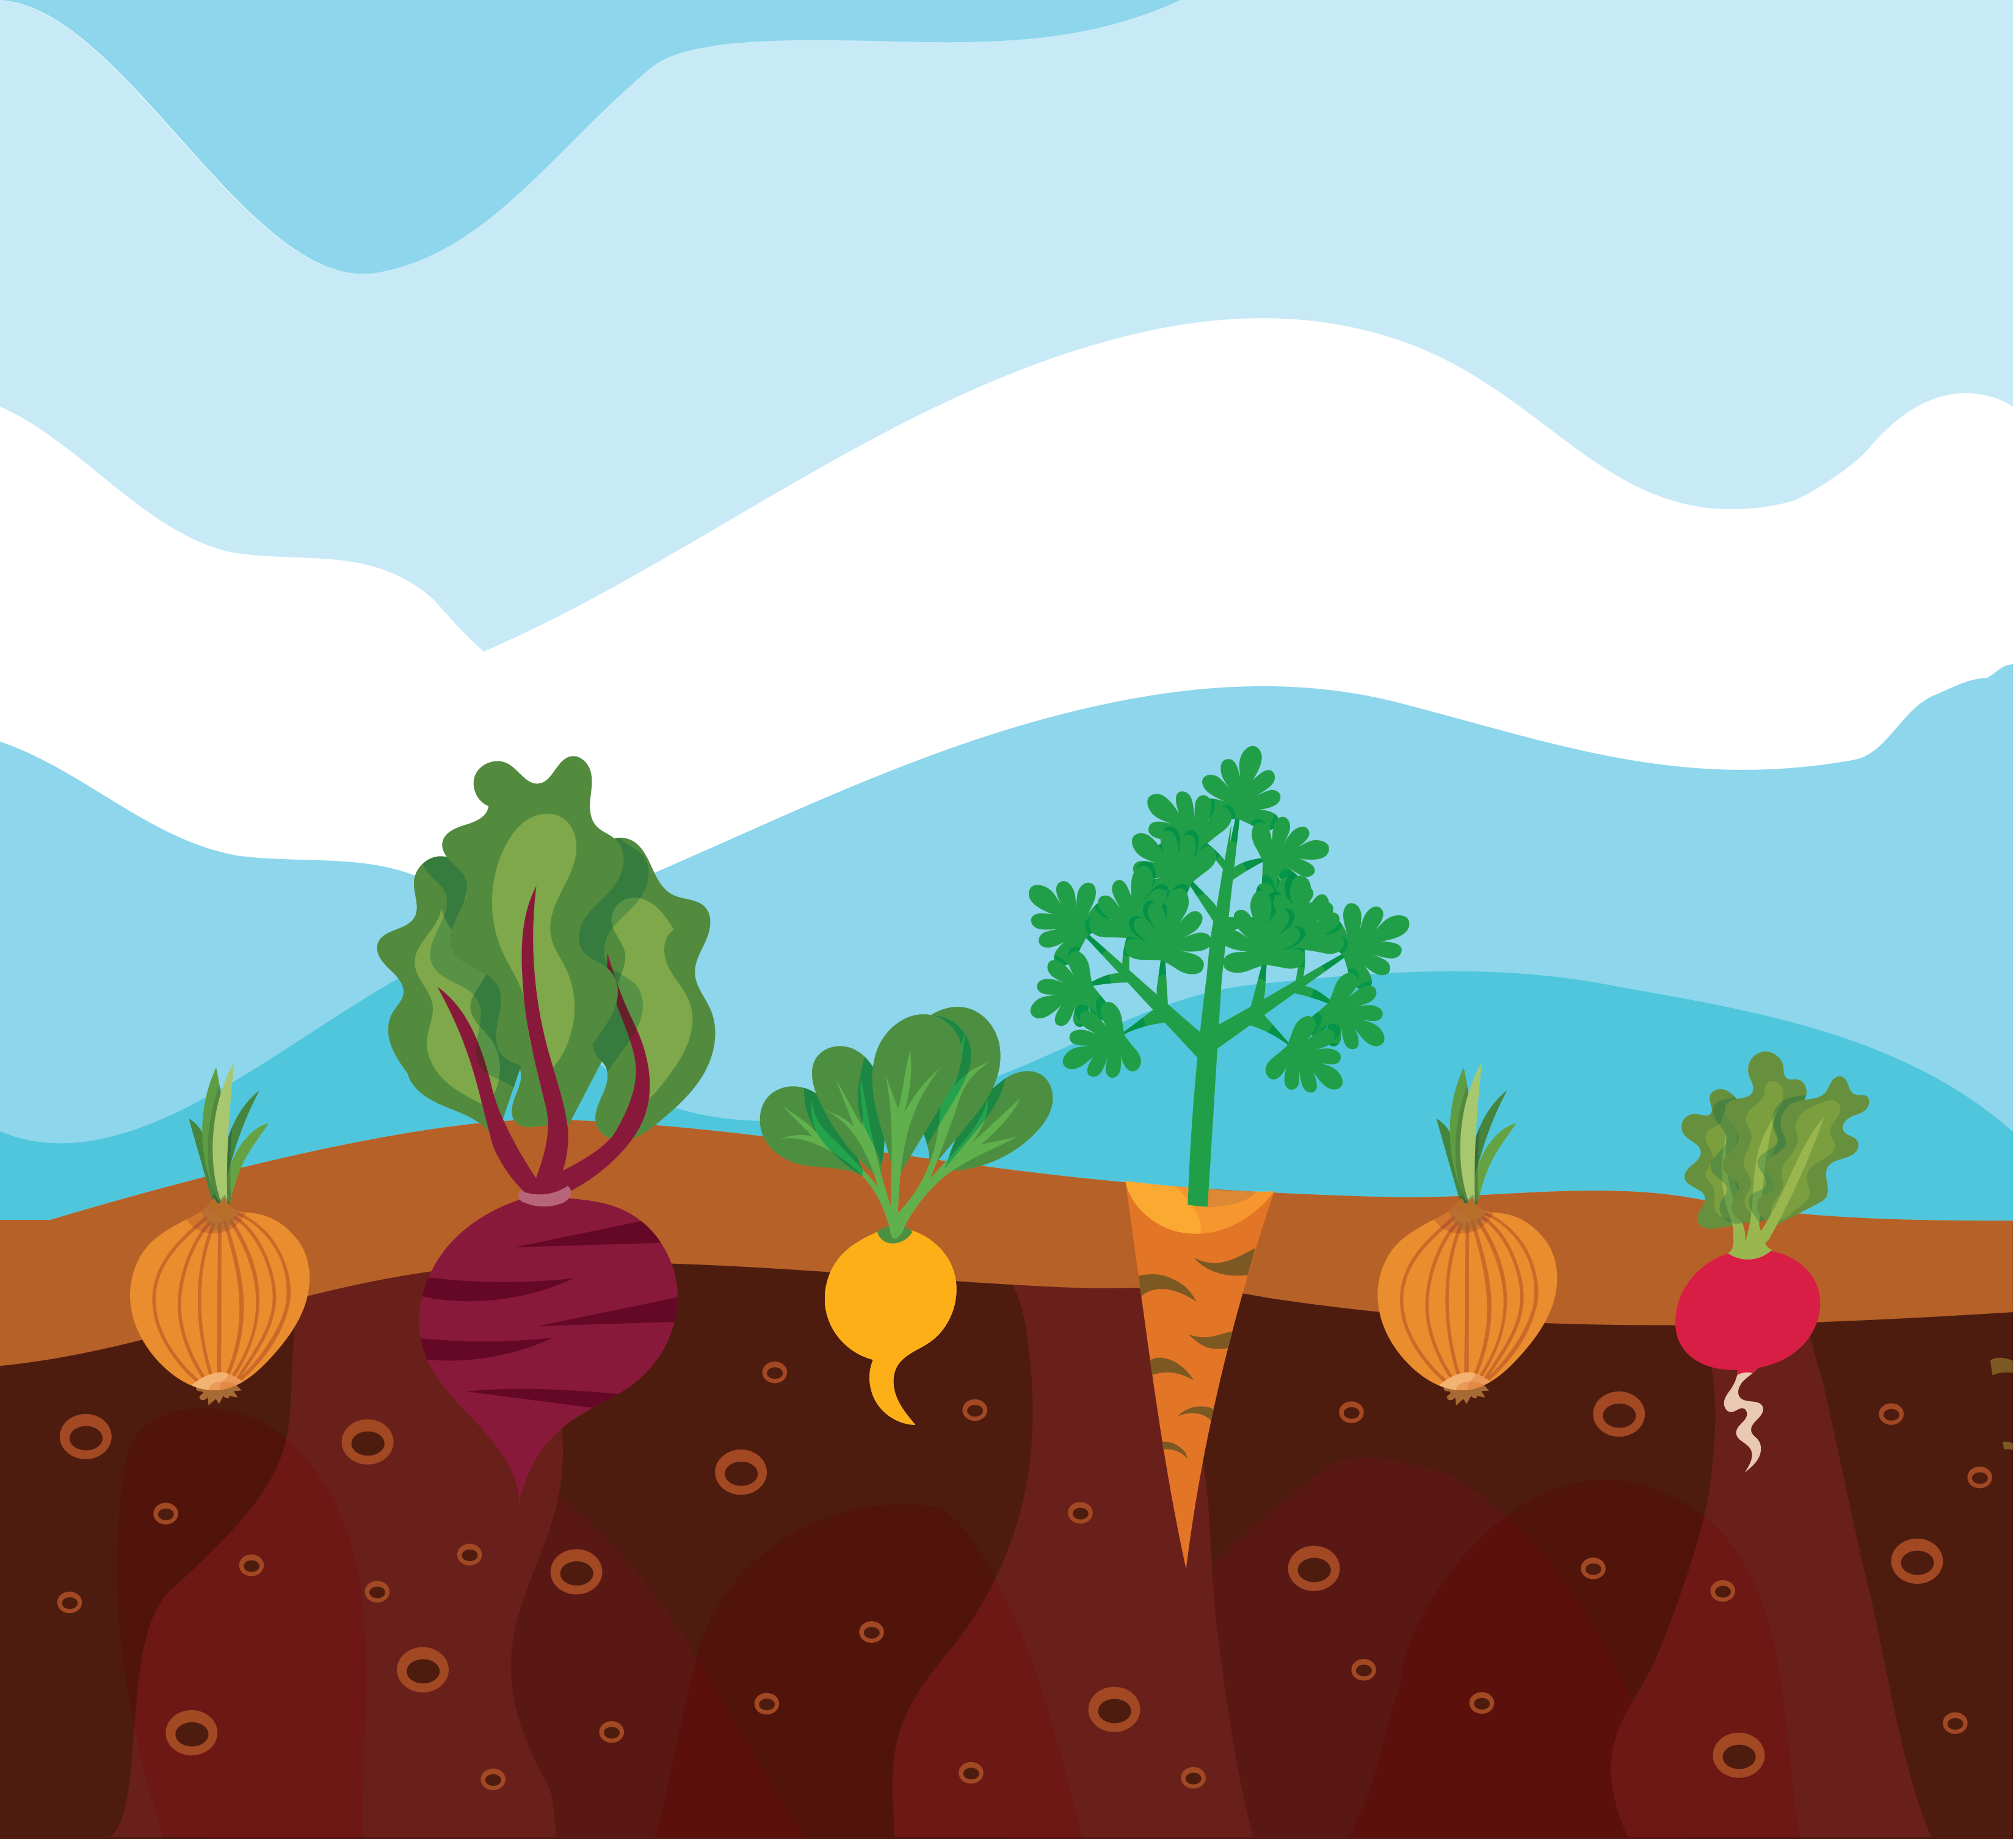
When we’re in a garden we may see the stalks of vegetables, but we don’t see what’s growing underground.
Notes:
<a href='https://www.freepik.com/vectors/background'>Background vector created by macrovector - www.freepik.com</a>

Slide 12
Notes:
<a href='https://www.freepik.com/vectors/background'>Background vector created by macrovector - www.freepik.com</a>

Slide 13
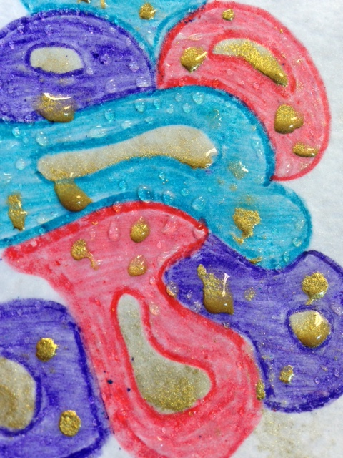
Wax and Water Don’t Mix
Dry Wax from a crayon acts as a resistant to watercolor paint.
No matter how much watercolor you put on the crayon wax, it won’t change color.
It will run off the wax and find places on the paper to color instead.

Slide 14
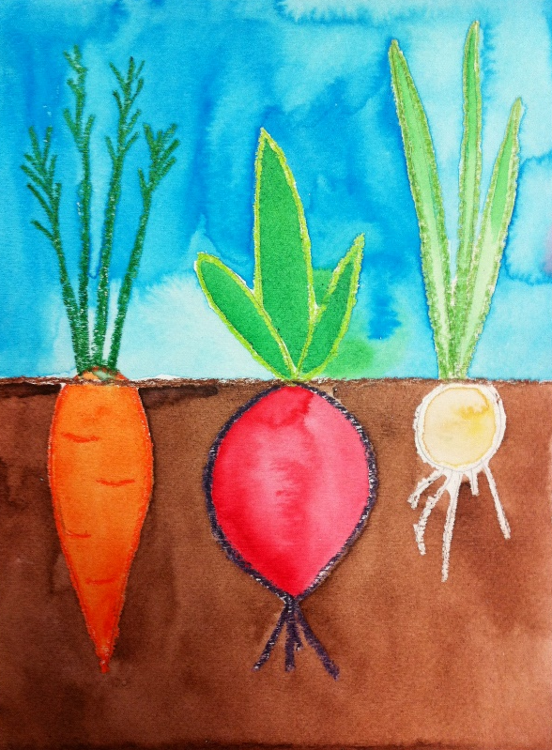
All in One Piece
Rule of Thirds
Rule of Odd Numbers
Variety
Perception
Resistance

Slide 15

GET YOUR SUPPLIES
8.5” x 11” Watercolor Paper
Crayons
Pencil
Dry Watercolor Palette
Watercolor Brush
Paint Palette
Water Cup
Paper Towels
Scrap Paper to Place Beneath Artwork

Slide 16
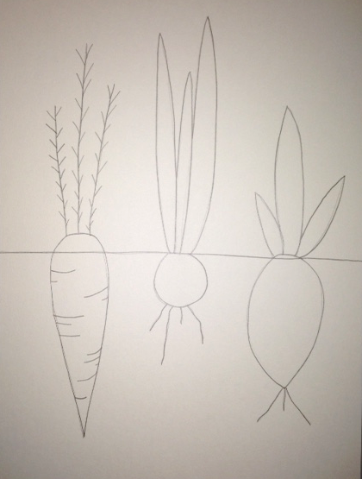
Step One - PENCIL
1) Put your name on your paper.
2) Draw a horizon line.
3) Draw a carrot, leak, and radish.

Slide 17
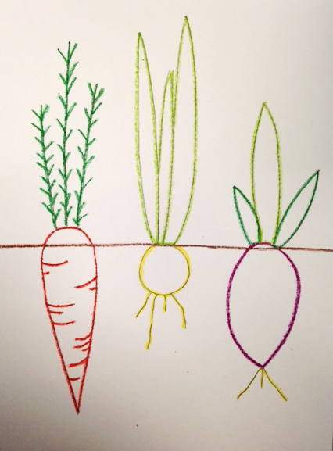

Step Two - CRAYON
Trace over the pencil lines with different colored crayons.
Make sure to trace over the horizon line.
REMINDER: Only outline the veggies, DO NOT color them in with crayon, that is what the watercolor paints are for.

Slide 18
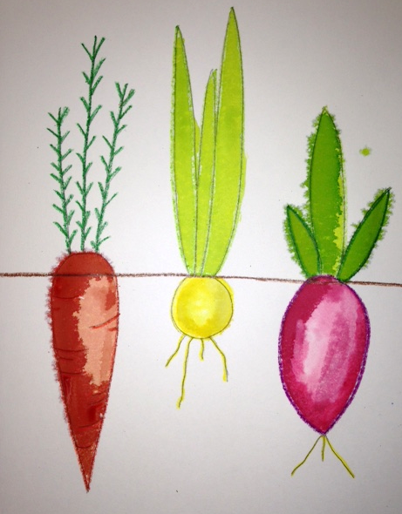


Step Three – WATERCOLOR PAINT
1) Paint inside the veggies first.
2) You can put water on the part of the paper first before painting.
3) You can darken the color by letting it dry a little first then adding to it with the same color.
Rinse your brush between colors so your palette doesn’t get super dirty.

Slide 19
FINAL STEPS – paint the top of the horizon line with blue, and the ground with brown.

Slide 20
Resources
Rule of Odd Numbers
Compositionstudy.com
“Teaching Art with Books Kids Love,” by Darcie Clark Frohardt
Dinosaur Graphic
Vegetable Illustration
Tree Graphics

