Slide 1
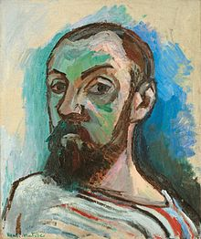
Henri matisse
1869 - 1954
Self Portrait, 1906

Slide 2
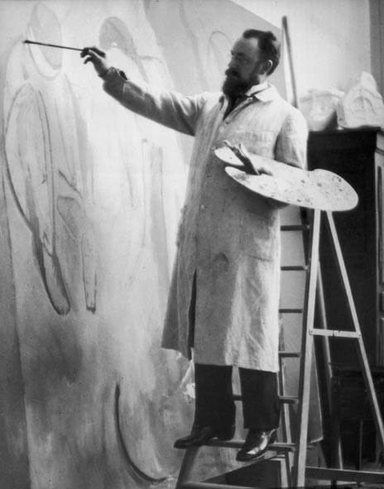
Henri matisse
Matisse was born in the north of France,
at Le Cateau-Cambresis, in 1869.
Unlike many great artists, Matisse didn’t show any interest in art while growing up.
Henri went to law school and became an assistant lawyer, but found it was really boring.

Slide 3
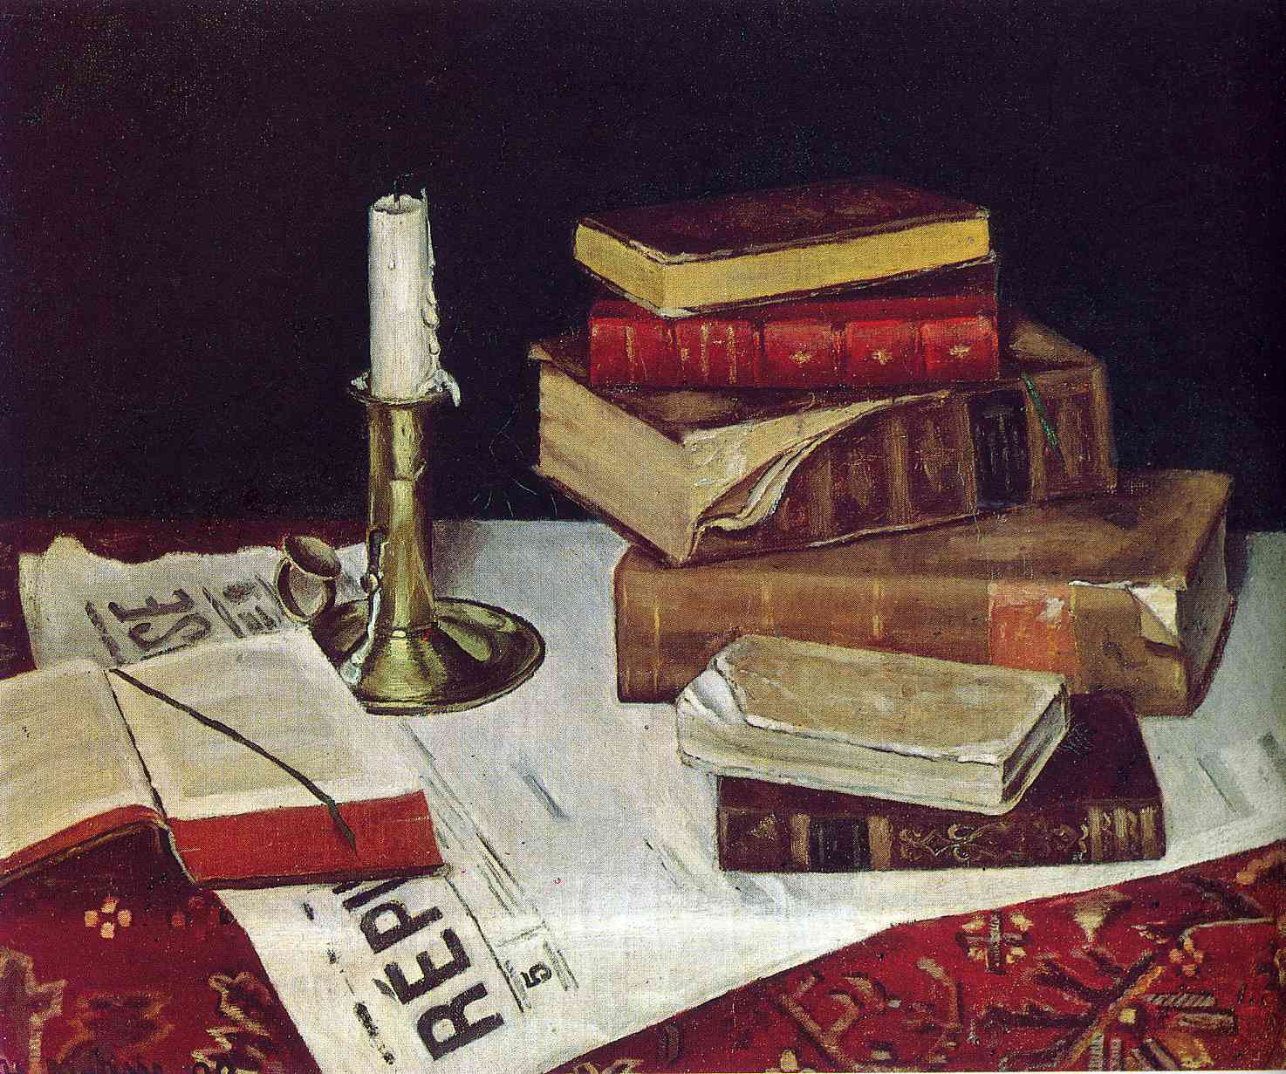
1890 early work
When Matisse was
20-years old he suffered from appendicitis and while recovering his mother gave him a box of paints to relieve his boredom.
Still Life with Books and Candle, 1890
Notes:
http://art-matisse.com/1890.html
He discovered "a kind of paradise" as he later described it.

Slide 4
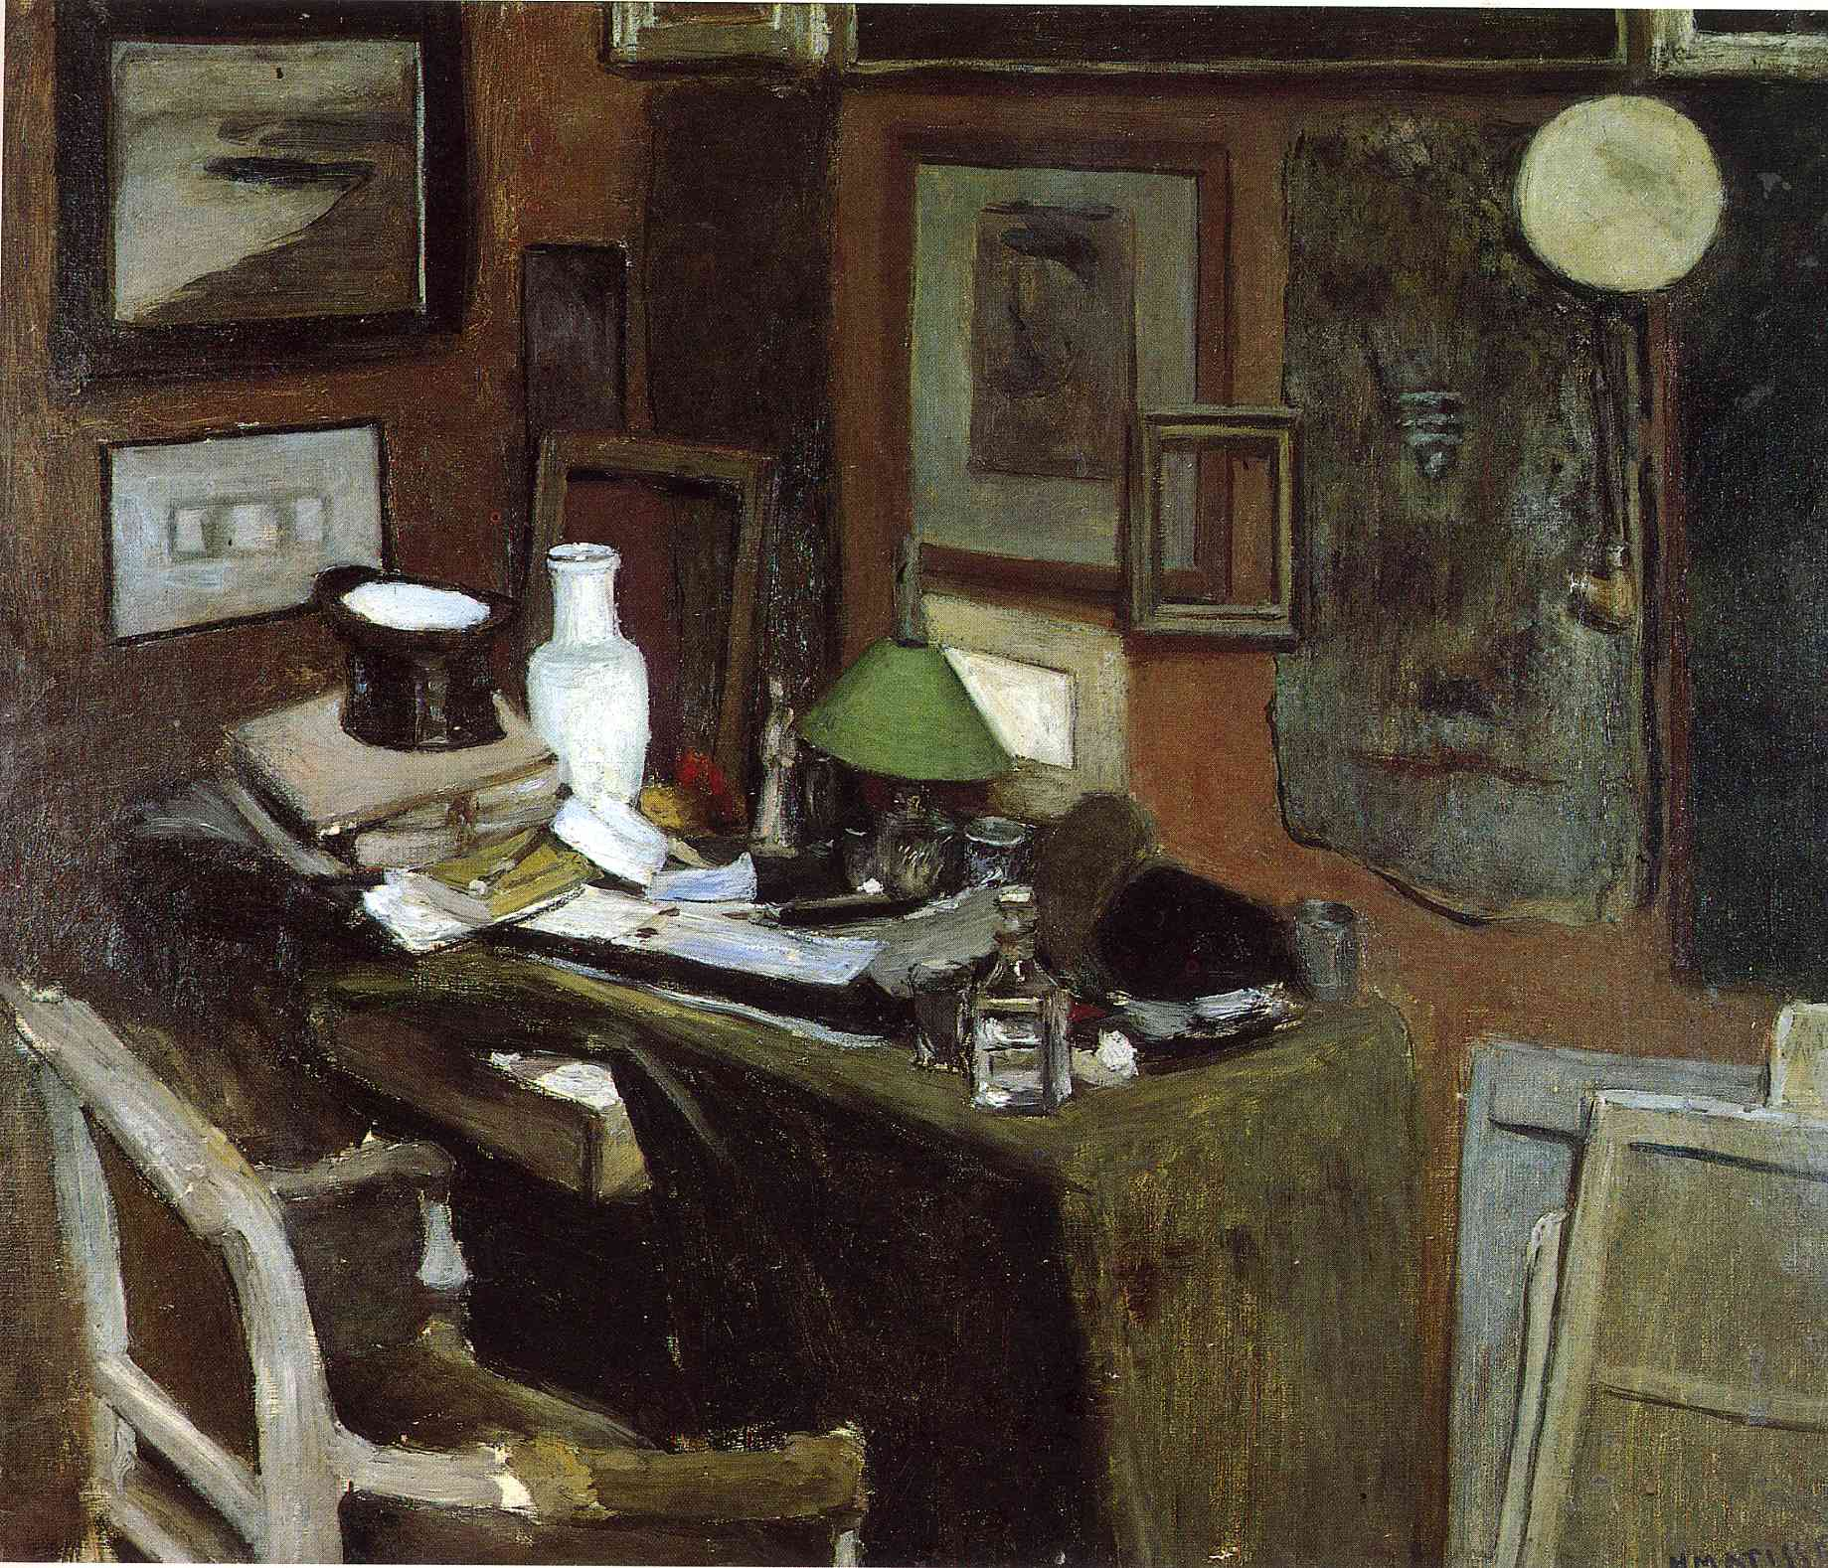
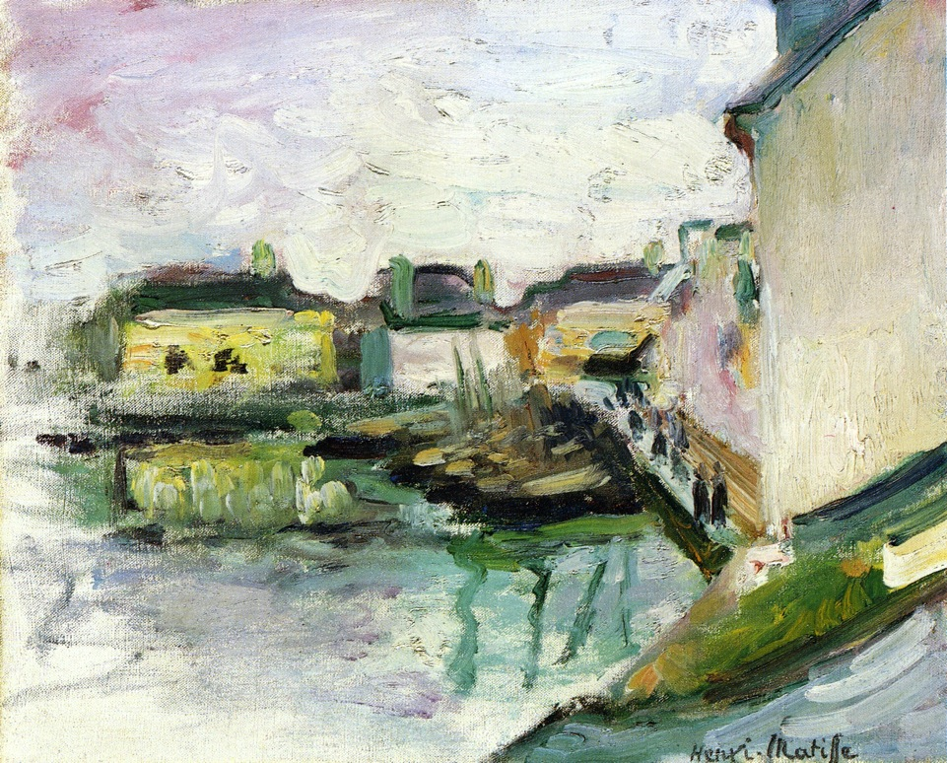
Becoming an artist as an adult
The Port of Palais, Belle Ile,1896
Interior with a top hat, 1896
Figuring Out Art was his Path
Catch Up
Matisse took art classes in the morning and went to work in the afternoon.
Matisse's parents weren’t happy with his change to becoming a full-time artist.
Matisse got into an art school in Paris, France.
He had to work very hard to learn concepts about art that the other art students had been working on for a long time.

Slide 5
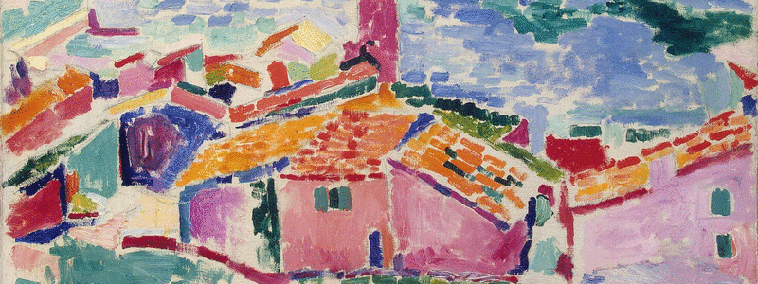
Henri matisse traveled to interesting places to paint.
He usually went to places that were bright and sunny.
He loved happy colors and simple shapes.
Les toits de Collioure, by Henri Matisse. 1905.
Oil on Canvas
Notes:
In 1896, Matisse, an unknown art student at the time, visited the Australian painter John Russell on the island Belle Île off the coast of Brittany.^{[13][14]} Russell introduced him to Impressionism and to the work of Vincent van Gogh—who had been a friend of Russell—and gave him a Van Gogh drawing.

Slide 6
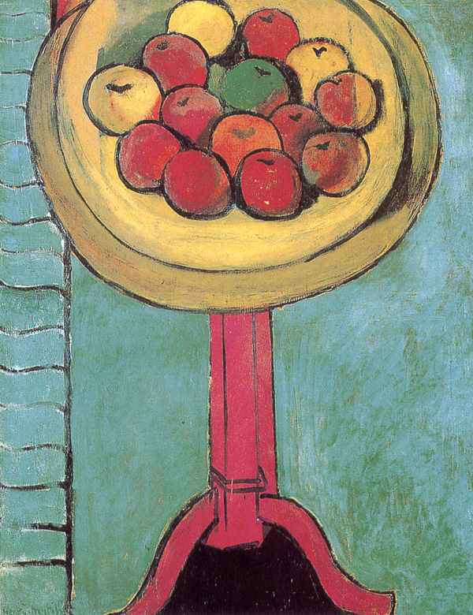
Starving artist
Matisse and his family struggled to earn enough money to live.
He would say that he was often tempted to eat the fruit he used as example for his still-life paintings.
And yet his paintings were bright, and happy, and wonderfully balanced.
Apples on a Table, Green Background,
by Henri Matisse. 1916. Oil on Canvas
Notes:
1898, he married Amélie Noellie Parayre; the two raised Marguerite together and had two sons, Jean (born 1899) and Pierre (born 1900). Marguerite and Amélie often served as models for Matisse.

Slide 7
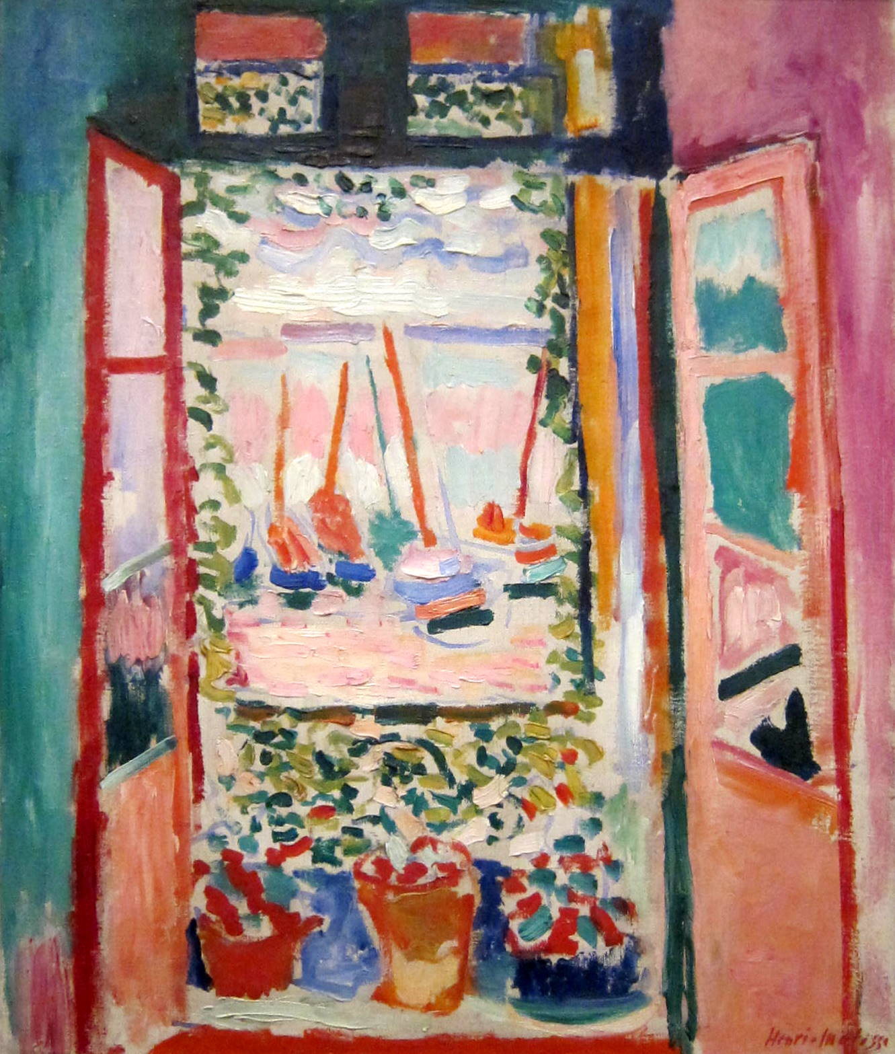
Wild beasts
In 1905, Matisse and his friends had an art show with their colorful paintings. The style of painting caused an uproar.
A writer that saw the show named the artists the Fauves, a French word that means “wild beasts.”
Open Window, by Henri Matisse. 1905. Oil on Canvas
Notes:
Matisse and a group of artists now known as "Fauves" exhibited together in a room at the Salon d'Automne in 1905.
The paintings expressed emotion with wild, often dissonant colours, without regard for the subject's natural colours.

Slide 8
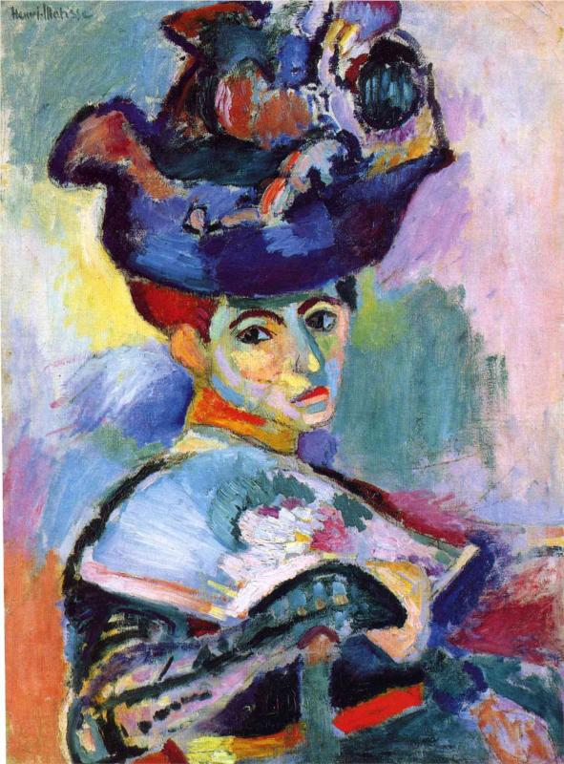
Wild beasts
Some people thought the Fauve artists just slopped on wild colors and were so insulted that they wanted to destroy the paintings.
This portrait is of Henri Matisse’s wife.
What color do you think her dress really was?
Woman with the Hat, by Henri Matisse. 1905. Oil on Canvas
Notes:
Matisse and a group of artists now known as "Fauves" exhibited together in a room at the Salon d'Automne in 1905.
The paintings expressed emotion with wild, often dissonant colours, without regard for the subject's natural colours.

Slide 9
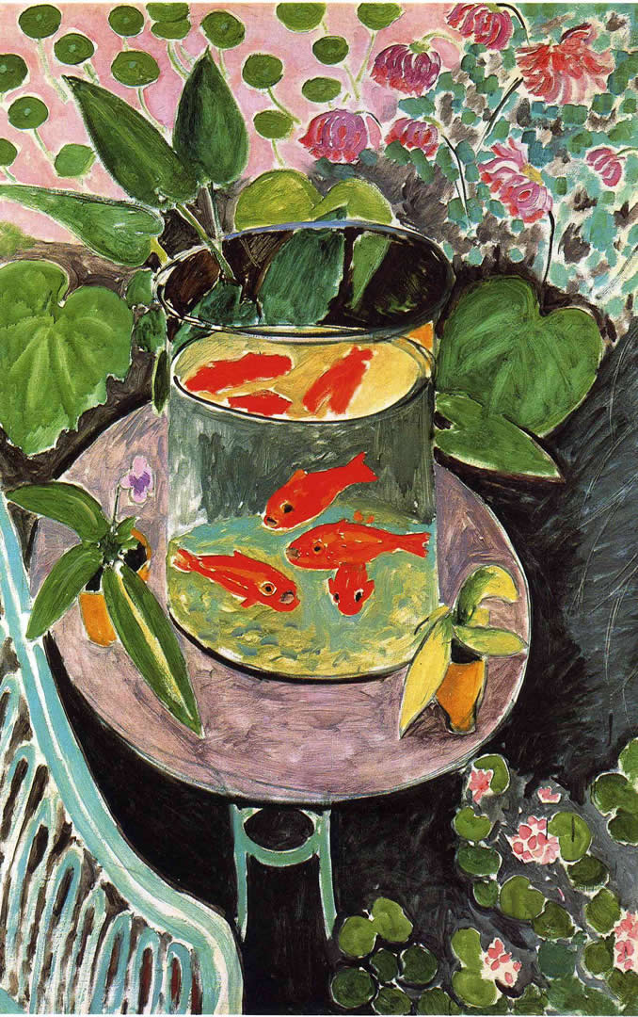
Soothing work
Matisse wanted his artwork to give people pleasure.
He wanted his work to be soothing—kind of like a comfortable armchair you can rest in after a hard day’s work.
The Goldfish, by Henri Matisse. 1911. Oil on Canvas

Slide 10
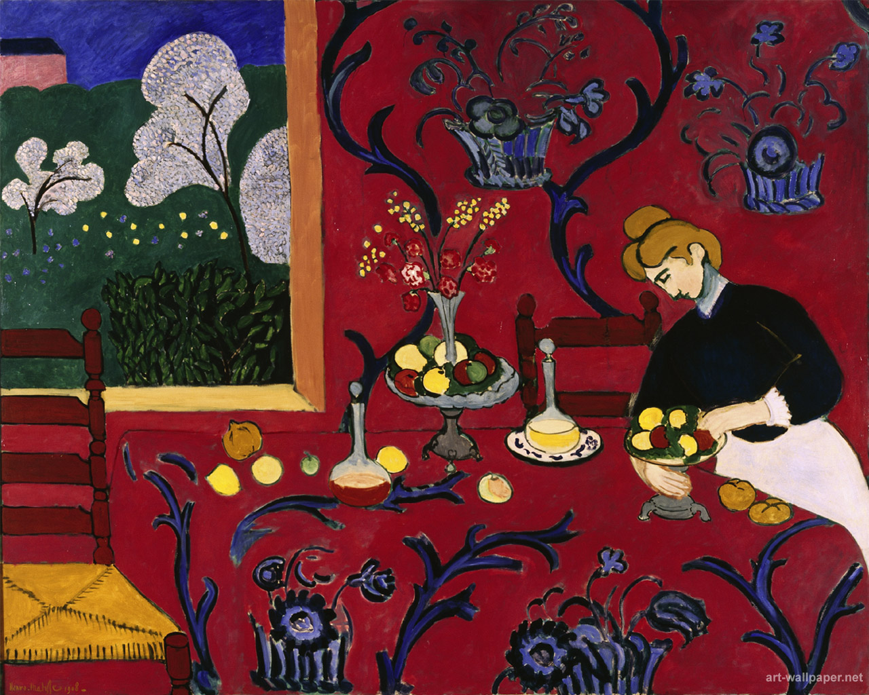
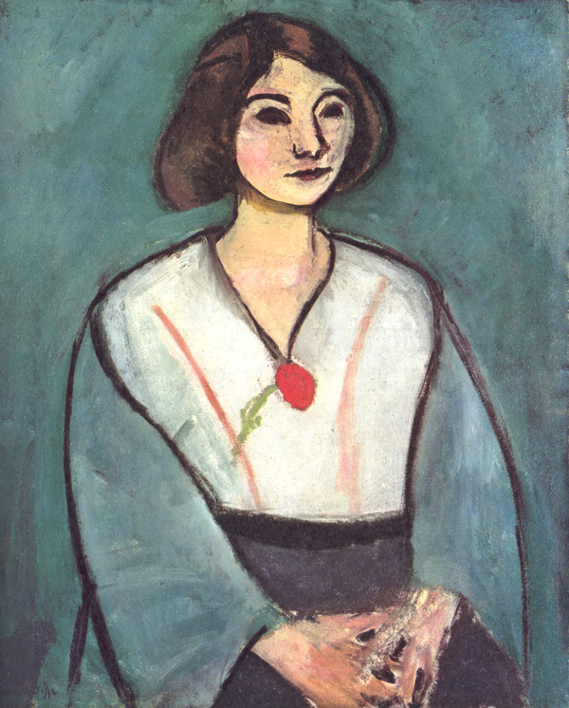
Simple & exciting designs
Henri Matisse liked designs on carpets and wallpaper, as well as people’s clothing. He liked to flatten his space with line and simple shapes.
Harmony in Red (The Tablecloth), by Henri Matisse. 1908. Oil on Canvas
Woman in Green, by Henri Matisse. 1909. Oil on Canvas
Notes:
Matisse and Picasso were long-time friends as well as rivals. One key difference between them is that Matisse drew and painted from nature, while Picasso was more inclined to work from imagination.

Slide 11
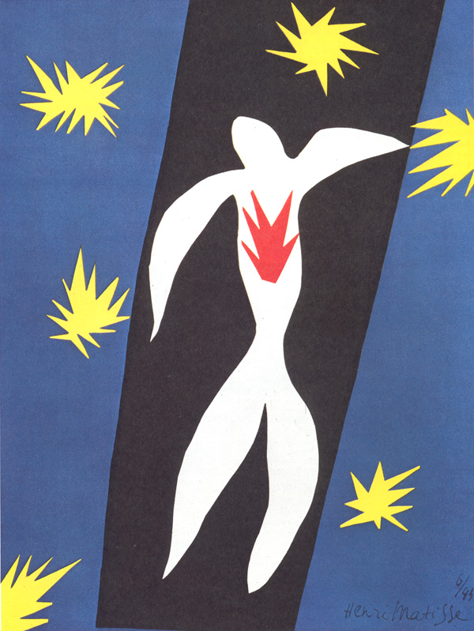
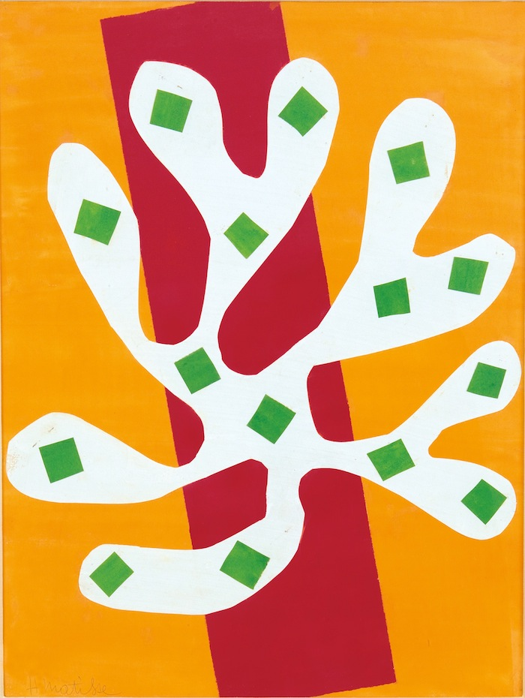
Changing with age
When Matisse got older and had trouble standing at his easel, he switched to a new form of art that could be done sitting.
What do you think Matisse used to make this artwork?
The Fall of Icarus, by Henri Matisse. 1943. Paper and Gouache.
Henri Matisse, White Alga on Orange and Red Background (Algue blanche sur fond orange et rouge), 1947. Gouache on paper, cut and pasted. 20 11/16 x 15 15/16 (52.5 x 40.5 cm). Mr. and Mrs. Donald B. Marron, New York. © 2015 Succession H. Matisse / Artists Rights Society (ARS), New York
Notes:
https://designobserver.com/feature/henri-matisse-the-lost-interview/38738
Diagnosed with abdominal cancer in 1941, Matisse underwent surgery that left him chair- and bedbound.
When Matisse got older and had trouble standing at his easel, Henri switched to a new form of art that could be done sitting.
He uses Gouache which is a watercolor-type of paint. It is more watery than acrylic paint but less fluid than watercolor.

Slide 12
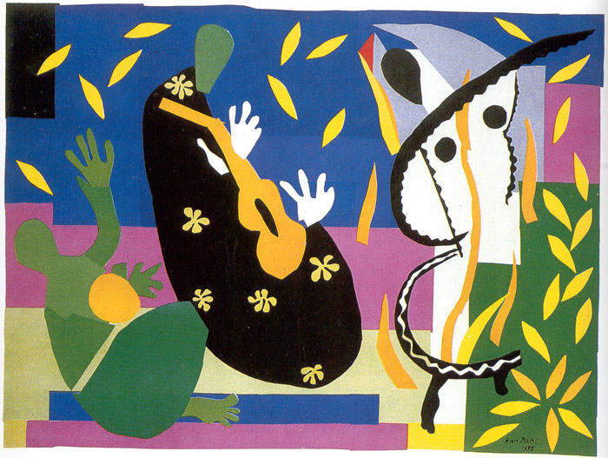
Drawing with scissors
He cut out shapes from brightly colored paper.
Henri Matisse said it was like drawing with scissors and sculpting with color.
The Sadness of the King, by Henri Matisse. 1952. Paper and Gouache.
Notes:
He uses Gouache which is a watercolor-type of paint. It is more watery than acrylic paint but less fluid than watercolor.
In 1952, he established a museum dedicated to his work, the Matisse Museum in Le Cateau, and this museum is now the third-largest collection of Matisse works in France. He passed away at the of 84.

Slide 13
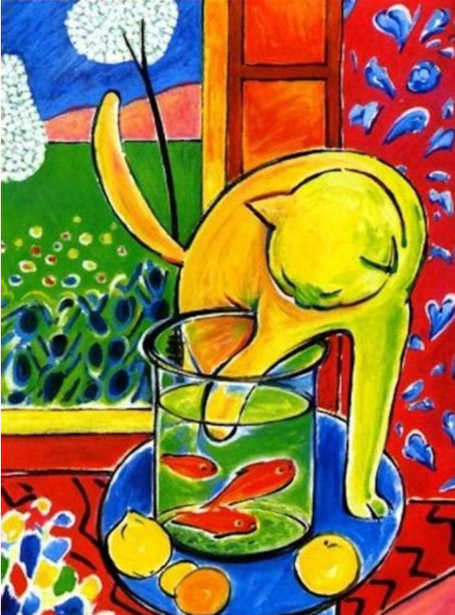
PAUSE TO GRAB YOUR SUPPLIES
8.5” X 11” White cardstock paper
Pencil & eraser
Paintbrush
Acrylic paint
Water cup
Paper towels
Paper plate
Cotton swabs
Scrap paper for under artwork

Slide 14
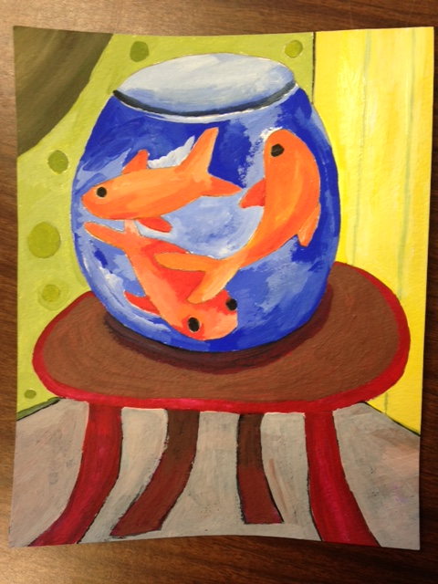
our project
The shapes should be large enough to fill in with a cotton swab or paintbrush.
Build and paint the table and walls around the fishbowl.
Simplicity of line and lack of detail reflects the style of Matisse.

Slide 15
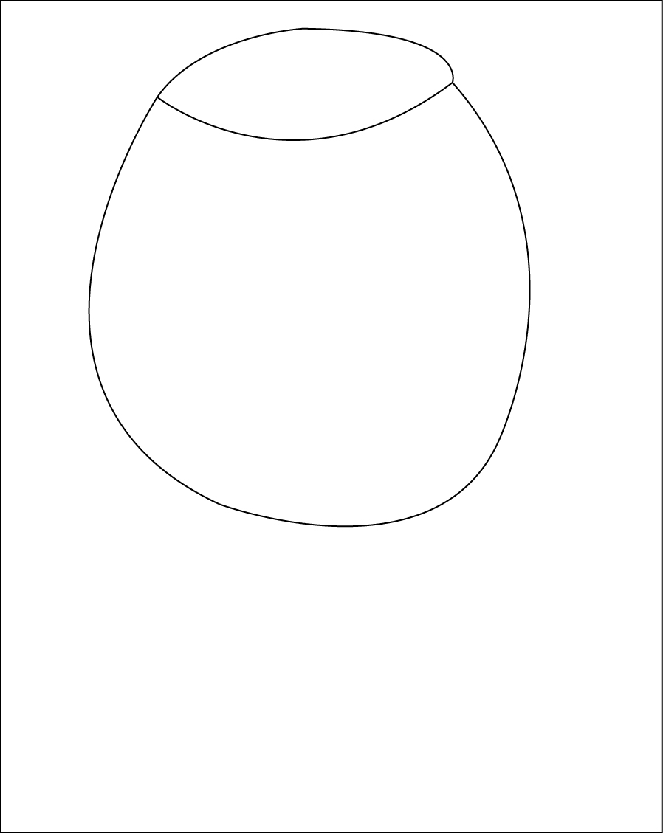
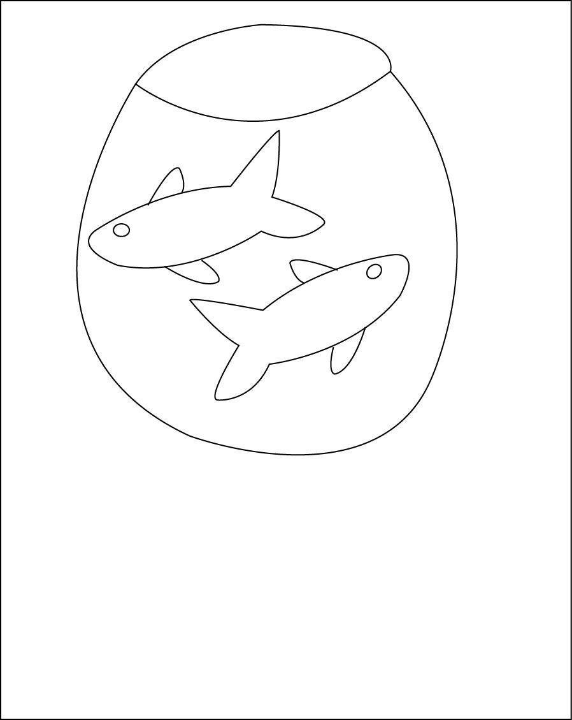
STEPS TO DRAW THE FISH IN BOWL
STEP
1
STEP
2

Slide 16
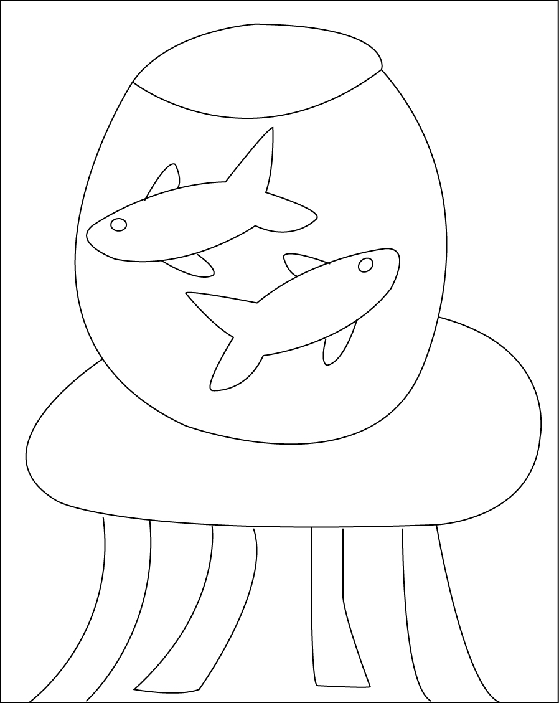
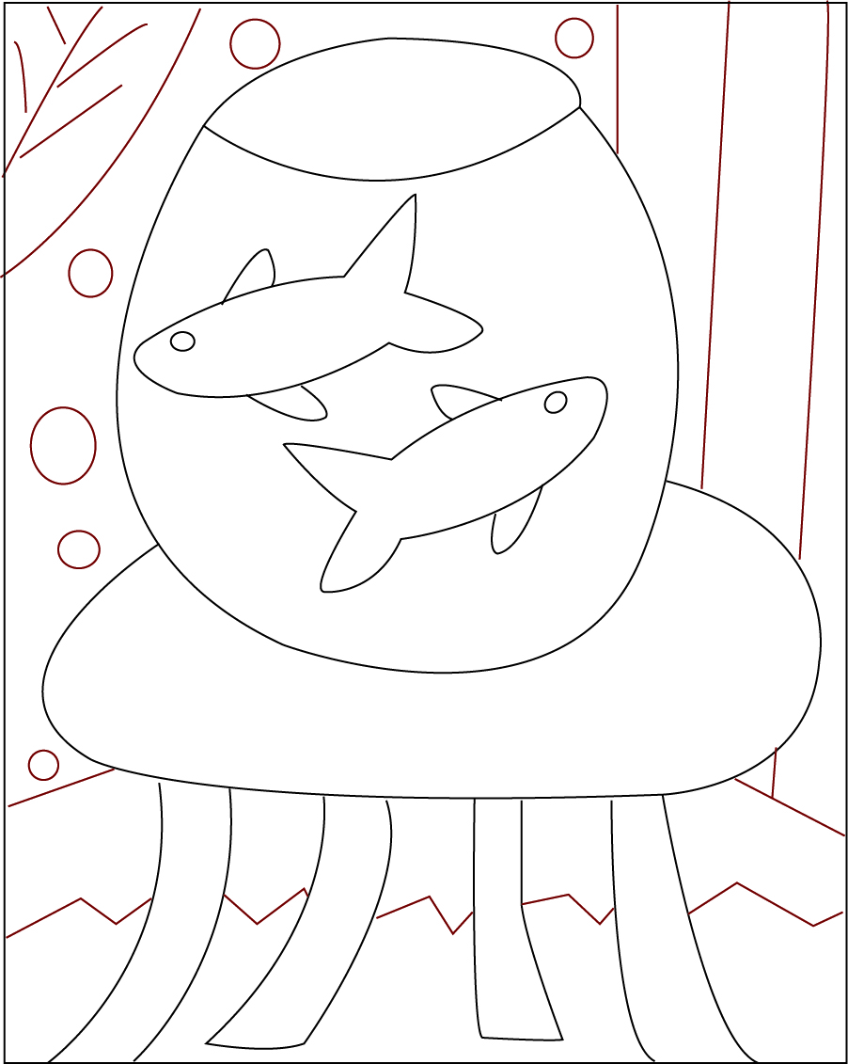
STEPS TO DRAW THE FISH IN BOWL
STEP
3
STEP
4

Slide 17
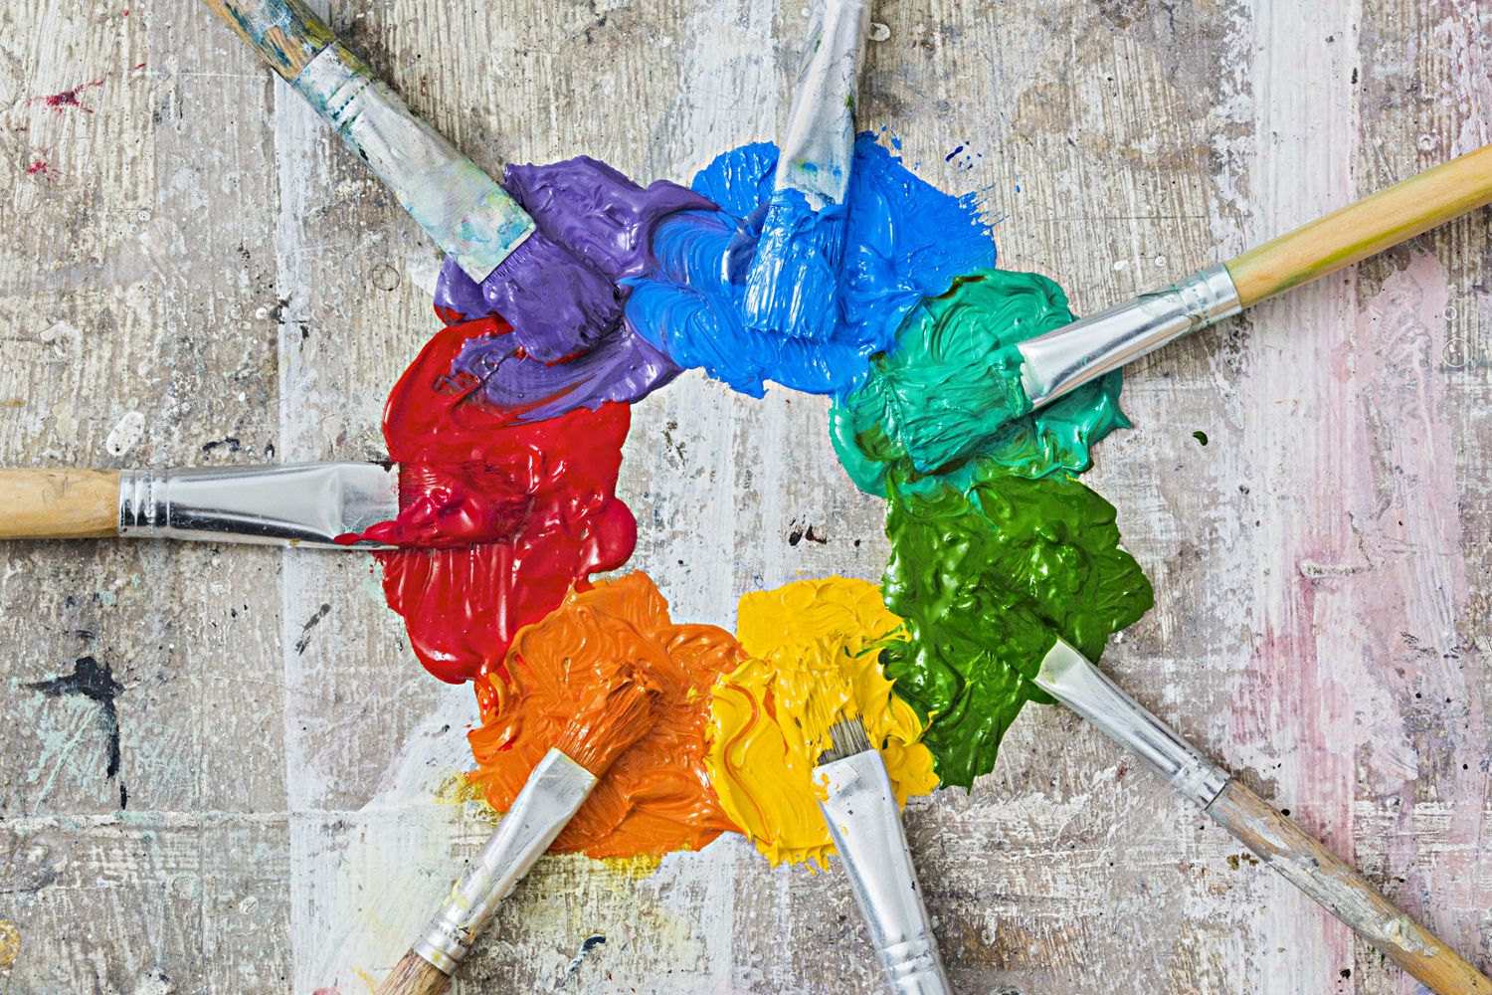
MAKE
YOUR
PALETTE
Notes:
https://www.thoughtco.com/thmb/EmAtDQ9v4nFBz_svQN4rpb4Gu5k=/1500x1000/filters:fill(auto,1)/Color-Wheel-Paints-57ec389e5f9b586c35c694e5.jpg

Slide 18
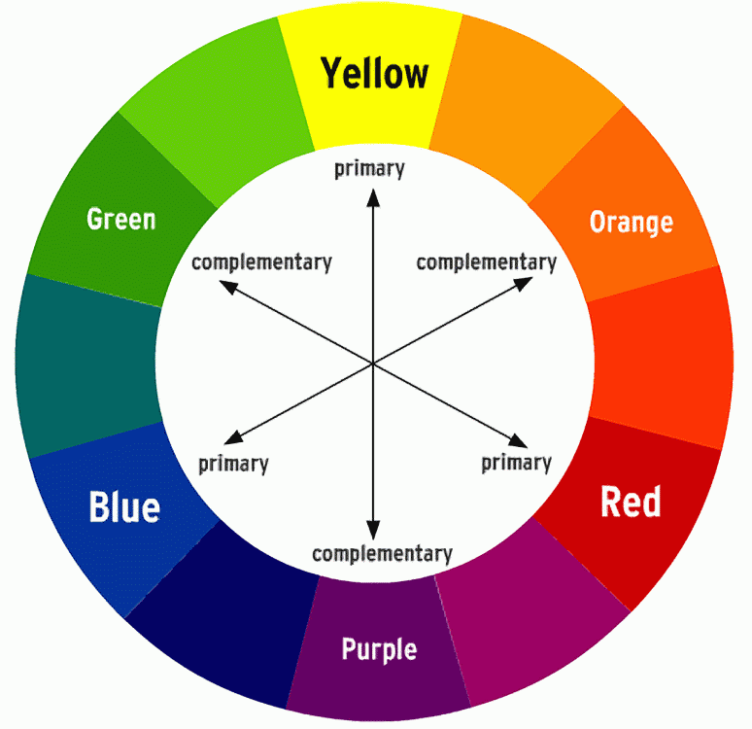
The Color Wheel
PRIMARY COLORS
Red • Blue • Yellow
SECONDARY COLORS ARE MIXTURES
OF PRIMARY COLORS
Red + Blue = Purple
Blue + Yellow = Green
Red + Yellow = Orange
COMPLEMENTARY COLORS
ARE OPPOSITES ON THE COLOR WHEEL
Purple and Yellow
Blue and Orange
Green and Red

Slide 19
Secondary Color Mixing Tip
Red + Blue = Purple
Blue + Yellow = Green
Red + Yellow = Orange
When mixing primary colors to make secondary colors, it is easier to add the darker of the two colors to the lighter one.
It doesn’t take a lot of the dark color to change the light one.
For example: If you want orange start with yellow and add red until you hit the orange you want. It takes a lot less paint to get there.

Slide 20
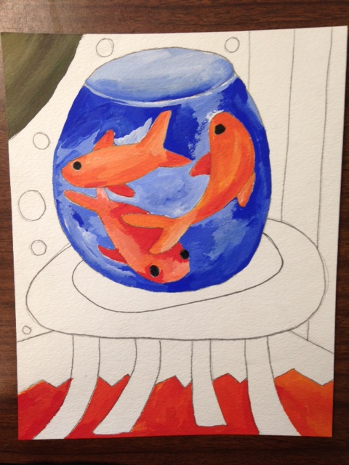
COLOR MIXING TIP
Color Mixing
If you want a light color, start with white and add a little bit of the darker color until you get the color you want.

Slide 21
USE COLOR TO CREATE
A HAPPY PLACE
Making a color little darker can look like a shadow. You can use the complementary color to make one look darker.
If you want one part of their painting to be bolder, let the section dry and then apply a second coat.

Slide 22
Resources
https://www.metmuseum.org/toah/hd/mati/hd_mati.htm
https://www.ducksters.com/biography/artists/henri_matisse.php
https://kids.kiddle.co/Henri_Matisse
https://en.wikipedia.org/wiki/Henri_Matisse
https://www.biography.com/artist/henri-matisse

